Slide 1


Slide 2
UNEXPLAINED INFERTILITY
Zahra Irani. MD.
ROYAN Institute

Slide 3
UNEXPLAINED INFERTILITY
Definition
Diagnosis
Treatment
Mechanical and surgical treatment
Alternative treatment

Slide 4
UNEXPLAINED INFERTILITY
Approximately 30% of infertile couples are considered to experience ‘unexplained infertility’ (UI). This controversial diagnosis is made when no abnormalities of the female and male reproductive systems are identified. The diagnosis of unexplained infertility presents a dilemma as it signifies both uncertainty about the cause of infertility and the potential for natural conception.
Zegers-Hochschild F, Adamson GD, Dyer S, Racowsky C, de Mouzon J, Sokol R, Rienzi L, Sunde A, Schmidt L, Cooke ID et al. The International Glossary on Infertility and Fertility Care, 2017. Hum Reported 2017;32:1786–1801.

Slide 5

Definition: Canadian Fertility and Andrology Society
Infertility is defined as the failure to achieve a clinical pregnancy after 12 months of regular unprotected sexual intercourse. Unexplained infertility (UEI) is defined as the absence of identifiable causes for the infertility. However, the diagnostic testing required to meet the definition of UEI that is most commonly described in the literature is based only on the presence of normal ovulatory function, a normal semen analysis and at least one patent Fallopian tube.
Guidelines for UI were released from the Canadian Fertility and Andrology Society (Buckett and Sierra, 2019)

Slide 6

Definition: ASRM
This evaluation would typically include the demonstration of at least one patent fallopian tube, documentation of ovulation of the female partner, and a semen analysis with an adequate number of motile sperm for the male partner.
American Society for Reproductive Medicine (ASRM) in 2020 (2020).

Slide 7

Definition: ESHRE
The GDG defines unexplained infertility as follows: infertility in couples with apparently normal ovarian function, fallopian tubes, uterus, cervix and pelvis, age ≤ 40 years and with adequate coital frequency; and apparently normal testicular function, genito-urinary anatomy and a normal ejaculate.

Slide 8

Definition: ICMART
The International Committee for Monitoring Assisted Reproductive Technologies (ICMART) defined UI as ‘infertility in couples with apparently normal Ovarian function, fallopian tubes, uterus, cervix and pelvis and with adequate coital frequency; and apparently normal testicular function, genito-urinary anatomy and a normal ejaculate. The potential for this diagnosis is dependent upon the methodologies used and/or those methodologies available.
Zegers-Hochschild et al., 2017

Slide 9
Definition: Novelty of ESHRE
the ESHRE guidelines on unexplained infertility have incorporated several novel aspects in the existing ICMART definition of unexplained infertility. Firstly, the guidelines introduce an age limit of up to 40 years for the woman’s age based on mathematical modelling of decline in fecundity with age. A defined age cut-off would allow to disaggregate unexplained infertility from age-related infertility, thus avoiding inappropriate interventions in women of advanced reproductive age, who are misdiagnosed as having unexplained infertility. Indeed, the false positive rate of diagnosing a woman with unexplained infertility is around 80% at 40 years of age.
Romualdi et al., 2023

Slide 10
Diagnosis
The diagnosis of ‘‘unexplained infertility’’ brings a double message. The glass is half full or half empty. Half full: there is nothing abnormal and this is reassuring; half empty: there is no identifiable reason why conception is not occurring and this is frustrating.
Ling Shan Au, Evaluating prognosis in unexplained infertility.2024

Slide 11
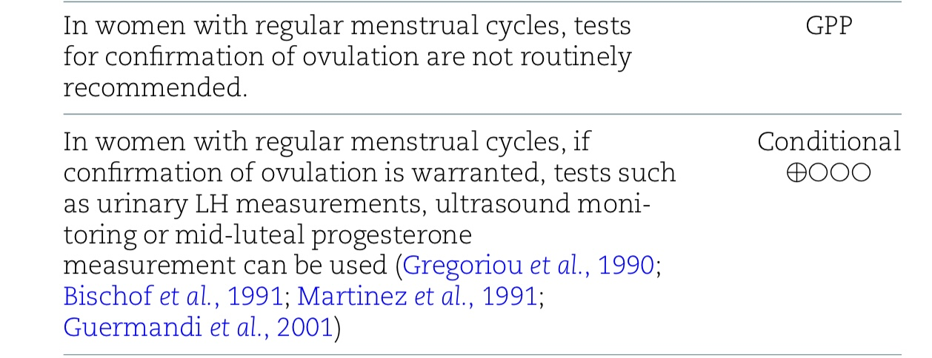
DIAGNOSIS CONFIRMATION OF OVULATION
The Guideline Group on Unexplained Infertility. Evidence-Based Guideline: Unexplained Infertility. ESHRE, 2023. https://www.eshre

Slide 12
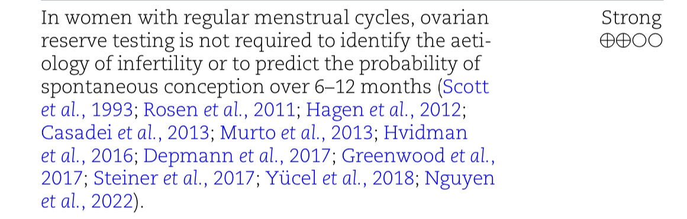
Diagnosis: OVARIAN RESERVE
The Guideline Group on Unexplained Infertility. Evidence-Based Guideline: Unexplained Infertility. ESHRE, 2023. https://www.eshre

Slide 13
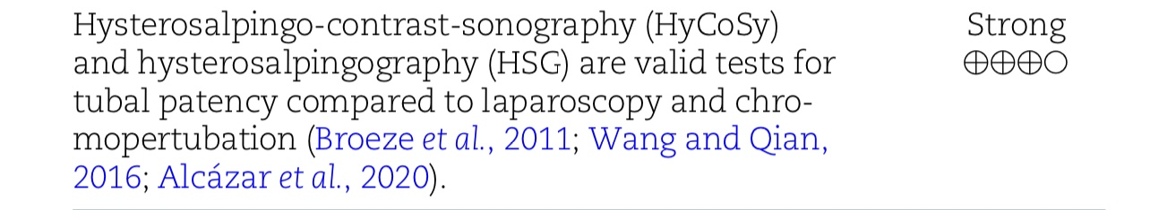
Diagnosis: Tubal Factor
The Guideline Group on Unexplained Infertility. Evidence-Based Guideline: Unexplained Infertility. ESHRE, 2023. https://www.eshre

Slide 14
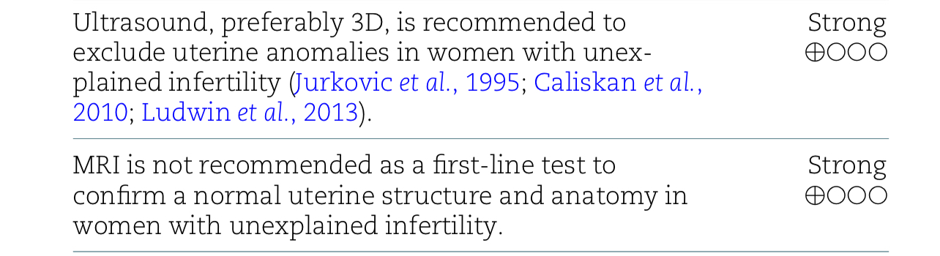
Diagnosis: UTERINE FACTOR
The Guideline Group on Unexplained Infertility. Evidence-Based Guideline: Unexplained Infertility. ESHRE, 2023. https://www.eshre

Slide 15
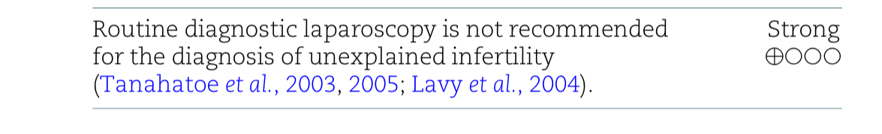
Diagnosis: LAPARASCOPY
The Guideline Group on Unexplained Infertility. Evidence-Based Guideline: Unexplained Infertility. ESHRE, 2023. https://www.eshre

Slide 16
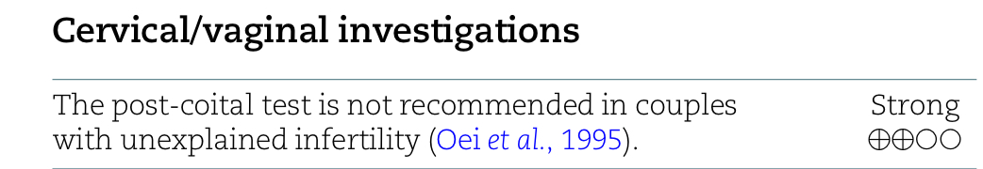
Diagnosis: CERVICAL INVESTIGATION
The Guideline Group on Unexplained Infertility. Evidence-Based Guideline: Unexplained Infertility. ESHRE, 2023. https://www.eshre

Slide 17
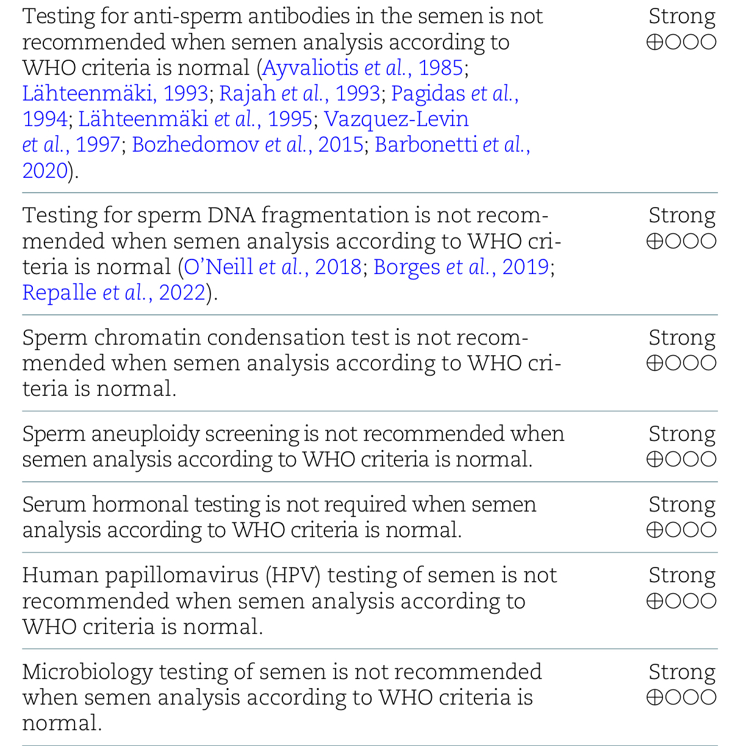
Diagnosis: MALE GENITOURINARY
The Guideline Group on Unexplained Infertility. Evidence-Based Guideline: Unexplained Infertility. ESHRE, 2023. https://www.eshre

Slide 18
Diagnosis
In a prospective cohort study including couples undergoing their first ICSI cycles for UI, the effect of sperm DNA fragmentation (SDF; by acridine orange test) on reproductive outcomes was investigated. Cumulative live birth rate was significantly higher in the low versus high SDF group (60.8% (59/97) vs. 41.7% (20/48)).
Repalle et al., 2022

Slide 19
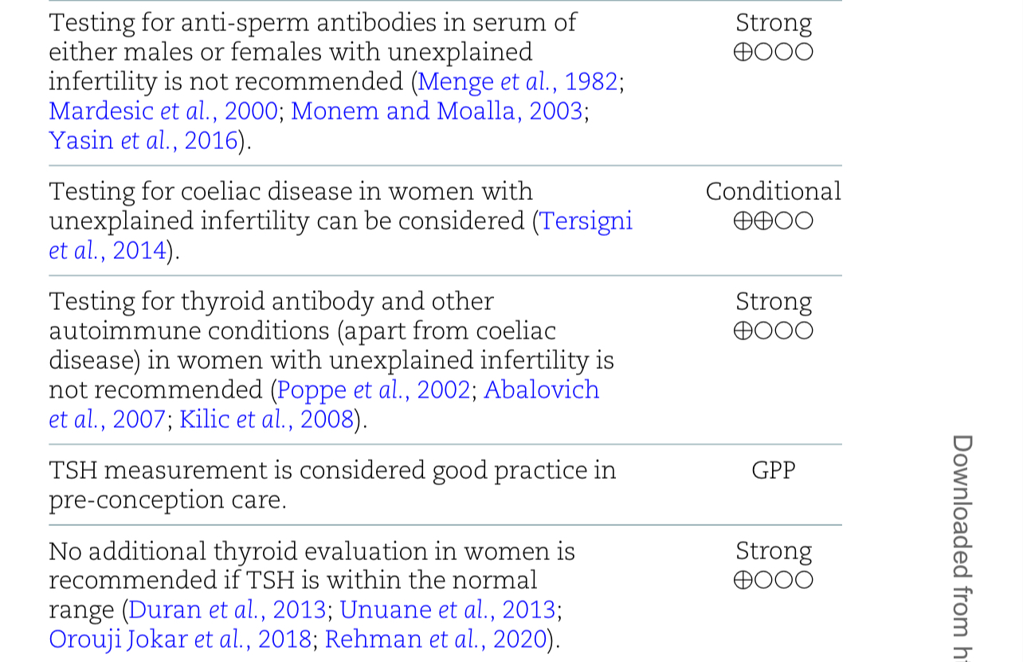
Diagnosis: systemic additional tests
The Guideline Group on Unexplained Infertility. Evidence-Based Guideline: Unexplained Infertility. ESHRE, 2023. https://www.eshre

Slide 20
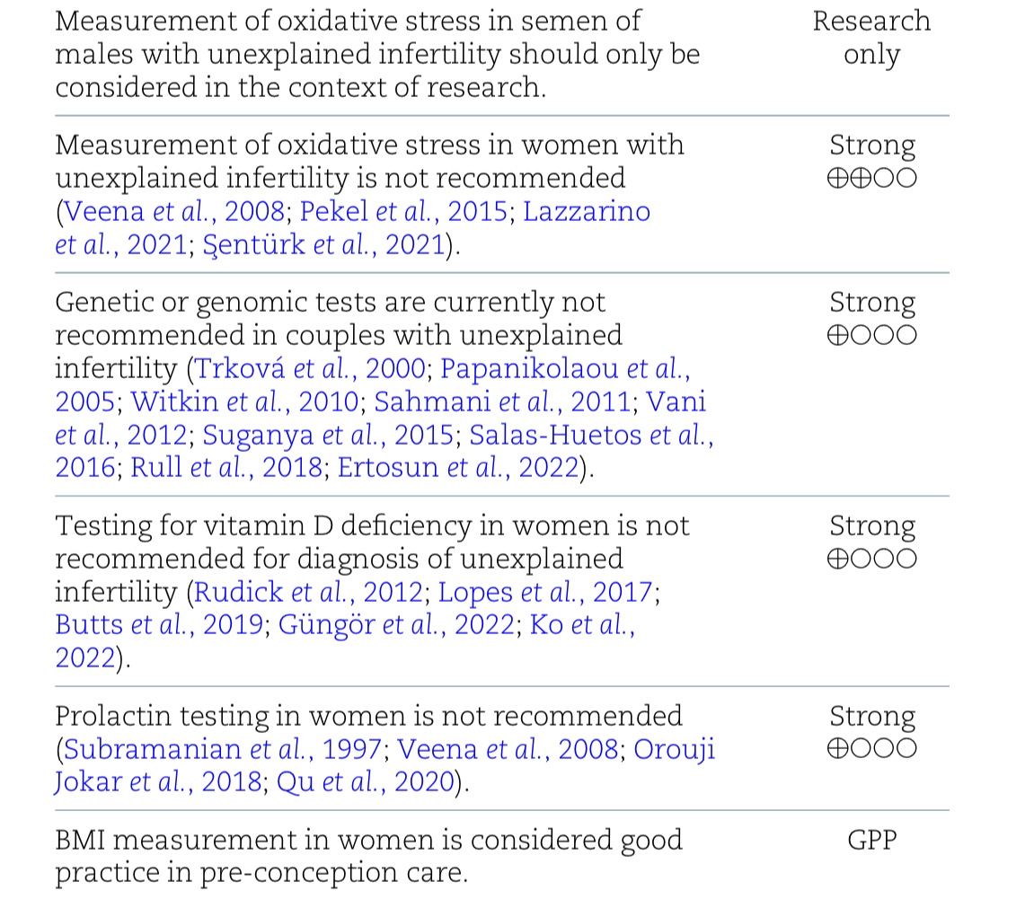
Diagnosis: systemic additional tests
The Guideline Group on Unexplained Infertility. Evidence-Based Guideline: Unexplained Infertility. ESHRE, 2023. https://www.eshre

Slide 21
TREATMENT
This condition presents a challenge in determining the optimal treatment approach. Available treatments include IUI and IVF, but guidelines vary on when to offer each. We will then demonstrate how prognosis can be used to determine which require treatment and at what stage of their infertility.
Prognosis-based management of unexplained infertility—why not? Laxmi Shingshetty.2024

Slide 22
TREATMENT: PREDICTION MODELS FOR TREATMENT
The largest prediction models have been integrated in the synthesis models of Hunault, which includes female age and infertility duration, having been pregnant before and motile sperm percentage. The main prognostic factor for natural fertility is obviously the age of the female partner. Female fertility starts to decline slowly after the age of 30 and decreases, with individual variation, exponentially from approximately 37 years. Other factors contributing to this prognosis include duration of infertility, previous conception, semen quality, and body mass index. The best way to integrate these components is in prediction models. Prediction models can be used to triage couples with unexplained infertility as having a good, intermediate, or poor prognosis for natural conception. The power of using the prediction models lies in their capacity to guide treatments.
Evaluating prognosis in unexplained infertility Ling Shan Au, 2024

Slide 23
Recommendation | Strengths
In couples with a good prognosis (based on age and duration of infertility) expectant management can be offered | (Level 1A)
Natural-cycle IUI does not offer any benefit over expectant management and should not be offered in UEI | (Level 1A)
Clomiphene citrate alone does not offer any benefit over expectant management and should not be offered to couples with UEI | (Level 1A)
Aromatase inhibitors alone do not offer any benefit in comparison to clomiphene citrate alone and should not be offered to couples with UEI | (Level 1A)
There is insufficient evidence to recommend gonadotropin-OS alone in the management of UEI | (level II)

Slide 24
Recommendation | Strengths
IUI with oral agents is an appropriate treatment in couples with UEI and is more effective than expectant management . | (Level 1A)
Gonadotropin/IUI can be offered to couples with UEI. | (Level 1B)
Patients should be aware that gonadotropin/IUI is associated with a higher pregnancy rate per cycle and a higher multiple pregnancy rate per cycle than IUI with oral agents . | (Level 1A)
IVF should be offered to couples with UEI after three cycles of ovarian stimulation/IUI have failed | (Level 1A)
IVF can be offered as an effective first-line treatment in UEI | (level IB)

Slide 25
TREATMENT: ASRM
1. It is recommended to use clomiphene citrate (A)
2. It is recommended that letrozole (A)
3. It is not recommended to use letrozole or clomiphene citrate plus conventional-dose gonadotropins (B)
4. It is not recommended to use low-dose gonadotropins (B)
5. It is not recommended to use conventional-dose gonadotropins with IUI (A)
6. It is recommended (typically 3 or 4 cycles) of OS and IUI with oral agents. For those unsuccessful with OS and IUI treatments with oral agents, IVF is recommended rather than OS and IUI with gonadotropins (B).
Evidence-based treatments for couples with unexplained infertility: guideline Practice Committee of the American Society for Reproductive Medicine American Society for Reproductive Medicine, Birmingham, Alabama

Slide 26
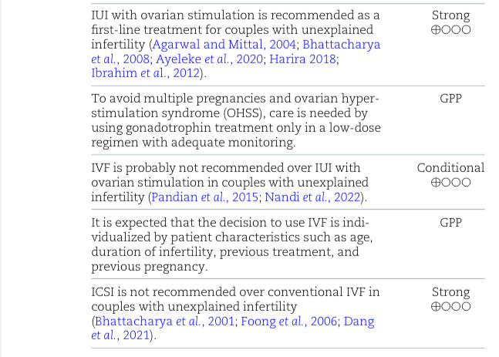
TREATMENT: ESHRE GUIDLINE

Slide 27
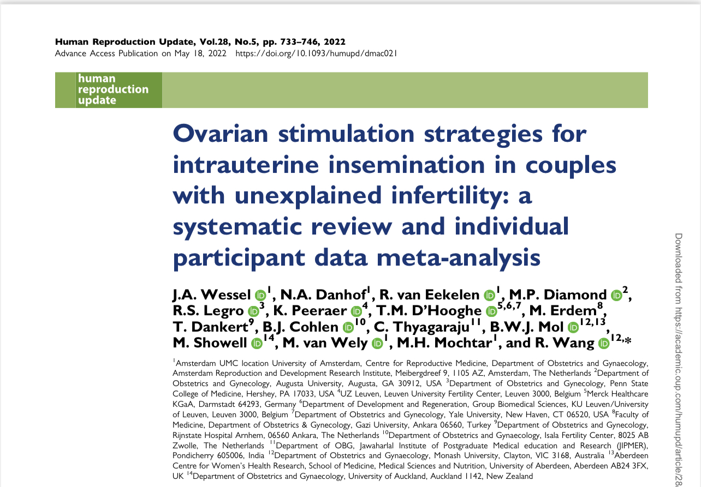
TREATMENT: CHALENGES

Slide 28
TREATMENT: CHALENGES
In couples with unexplained infertility undergoing IUI-OS, gonadotrophins increased the chance of a live birth and reduced the time to conception compared to CC, at the cost of a higher multiple pregnancy rate, when not differentiating strategies on cancellation criteria or the starting dose.
The treatment effects did not seem to differ in women with different age, BMI or primary versus secondary infertility.
Intrauterine insemination in couples with unexplained infertility: a systematic review and individual participant data meta-analysis J.A. Wessel.2024

Slide 29
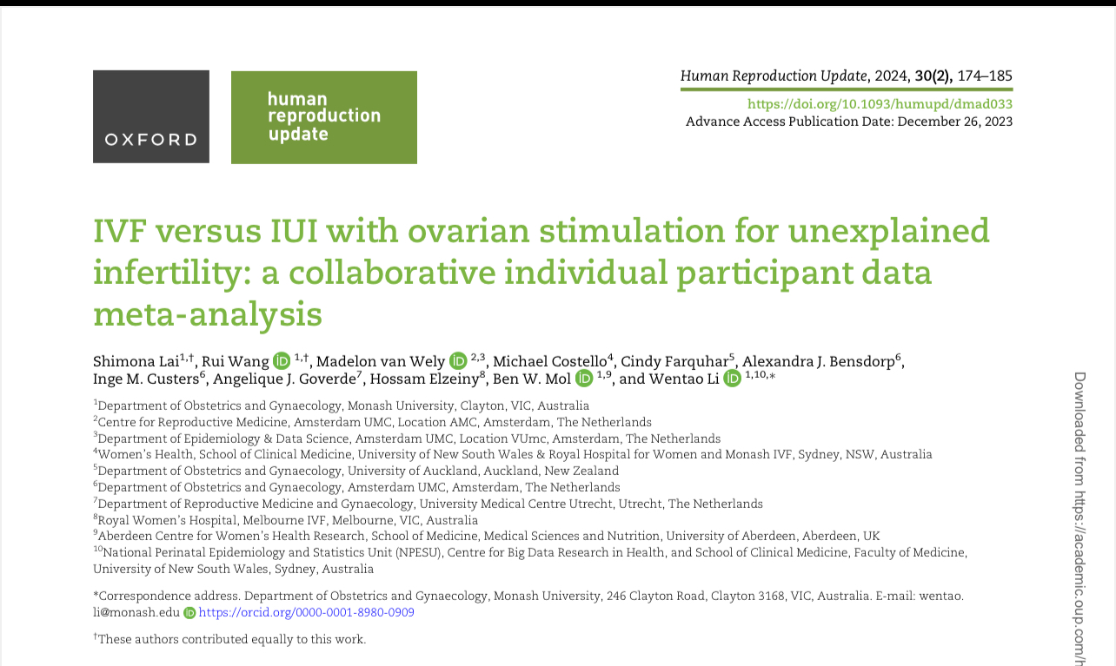
TREATMENT: CHALENGES

Slide 30
TREATMENT: CHALENGES
IVF and IUI with ovarian stimulation (IUI-OS) are widely used in managing unexplained infertility. IUI-OS is generally considered first-line therapy, followed by IVF only if IUI-OS is unsuccessful after several attempts. However, there is a growing interest in using IVF for immediate treatment because it is believed to lead to higher live birth rates and shorter time to pregnancy.
No significant difference between IVF and IUI OS in couples with unexplained infertility regarding cumulative live birth, multiple pregnancy, clinical pregnancy, pregnancy loss, gestational age at delivery, and birthweight at delivery. Subgroup analysis showed no significant difference in cumulative live birth in couples of differing female ages, duration of infertility, type of infertility, or sperm analysis results.
IVF versus IUI with ovarian stimulation for unexplained infertility: a collaborative individual participant data meta-analysis Shimona Lai1,†2024

Slide 31
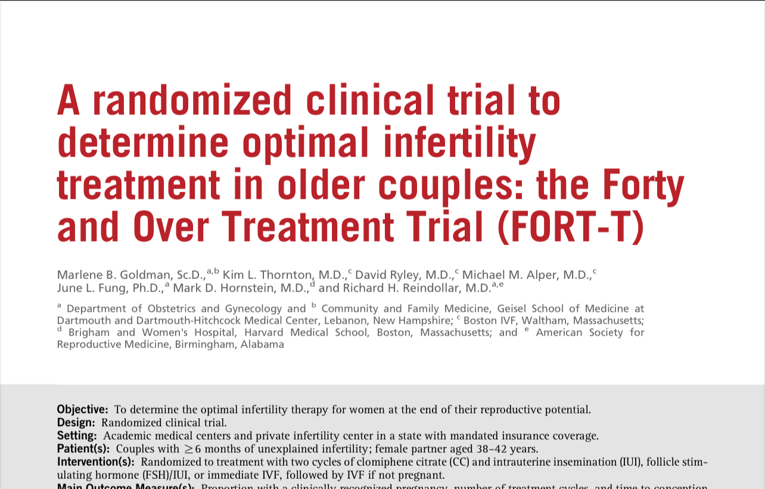
TREATMENT: CHALENGES

Slide 32
TREATMENT: CHALENGES
The cumulative clinical pregnancy rates per couple after the first two cycles of CC/IUI, FSH/IUI, or immediate IVF were 21.6%, 17.3%, and 49.0%, respectively. 84.2% of all live-born infants resulting from treatment were achieved via IVF. There were 36% fewer treatment cycles in the IVF arm compared with either COH/IUI arm, and the couples conceived a pregnancy leading to a live birth after fewer treatment cycles.
A randomized clinical trial to determine optimal infertility treatment in older couples: the Forty and Over Treatment Trial (FORT-T) Marlene B. Goldman

Slide 33
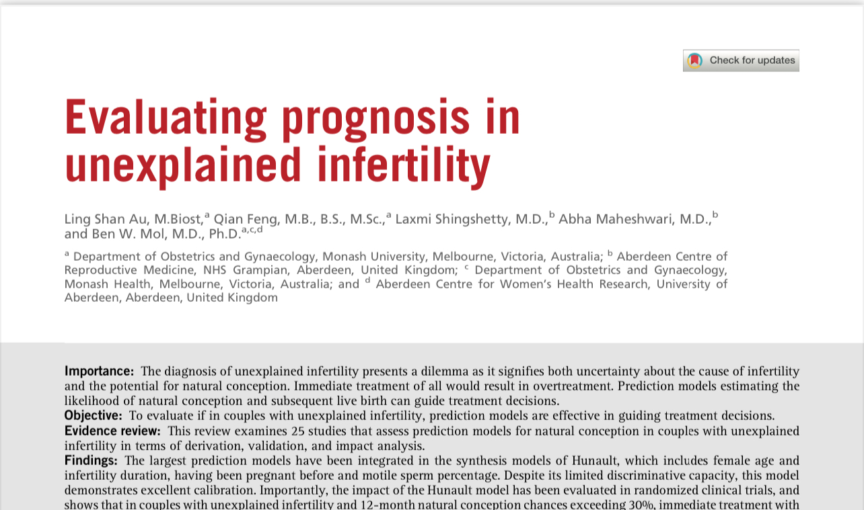
TREATMENT: CHALENGES

Slide 34
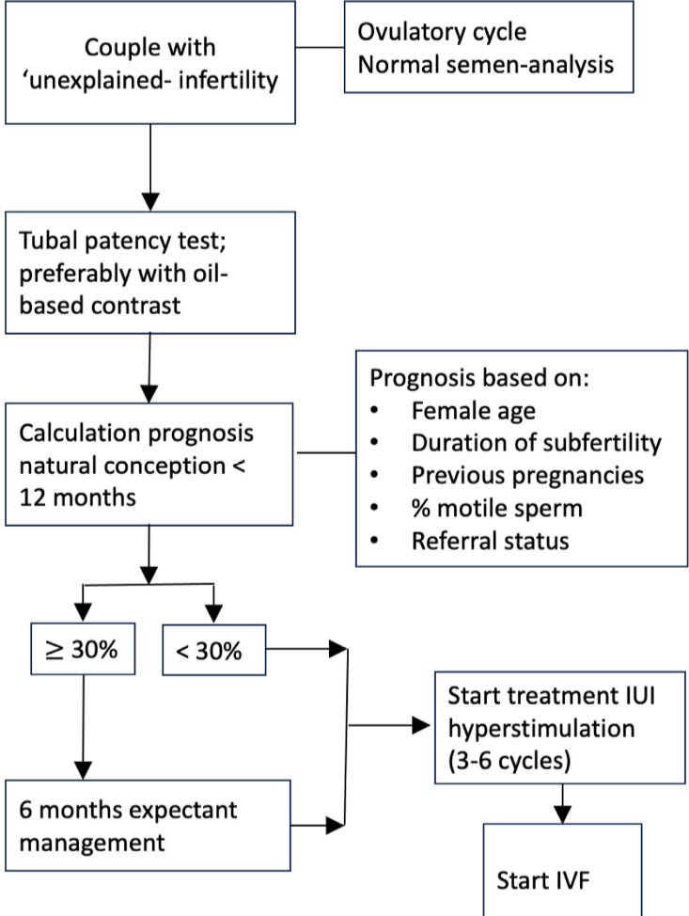
TREATMENT: CHALENGES
Evaluating prognosis in unexplained infertility Ling Shan.2024

Slide 35
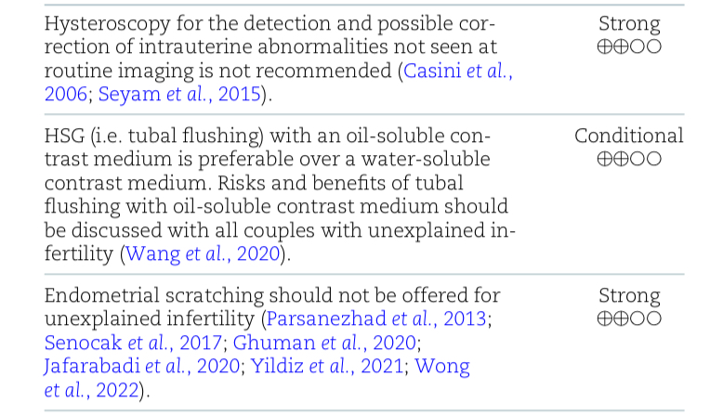
TREATMENT: SURGICAL AND MECHANICAL
The Guideline Group on Unexplained Infertility. Evidence-Based Guideline: Unexplained Infertility. ESHRE, 2023. https://www.eshre

Slide 36
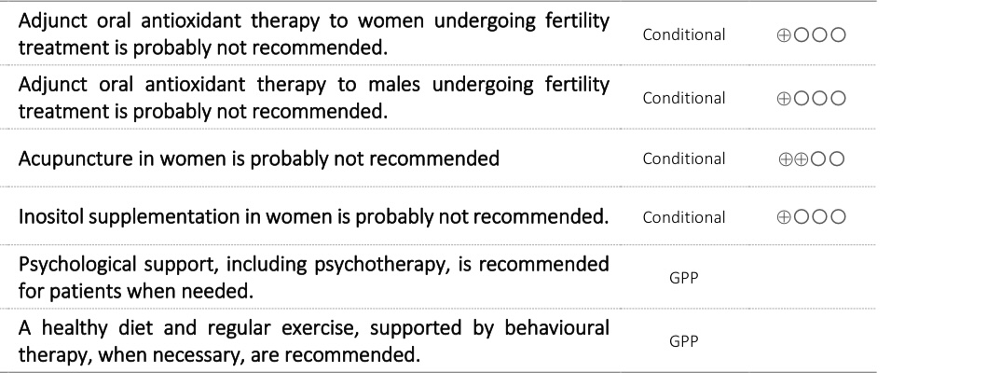
ALTERNATIVE TREATMENT
The Guideline Group on Unexplained Infertility. Evidence-Based Guideline: Unexplained Infertility. ESHRE, 2023. https://www.eshre

Slide 37

THANK YOU

