Slide 1
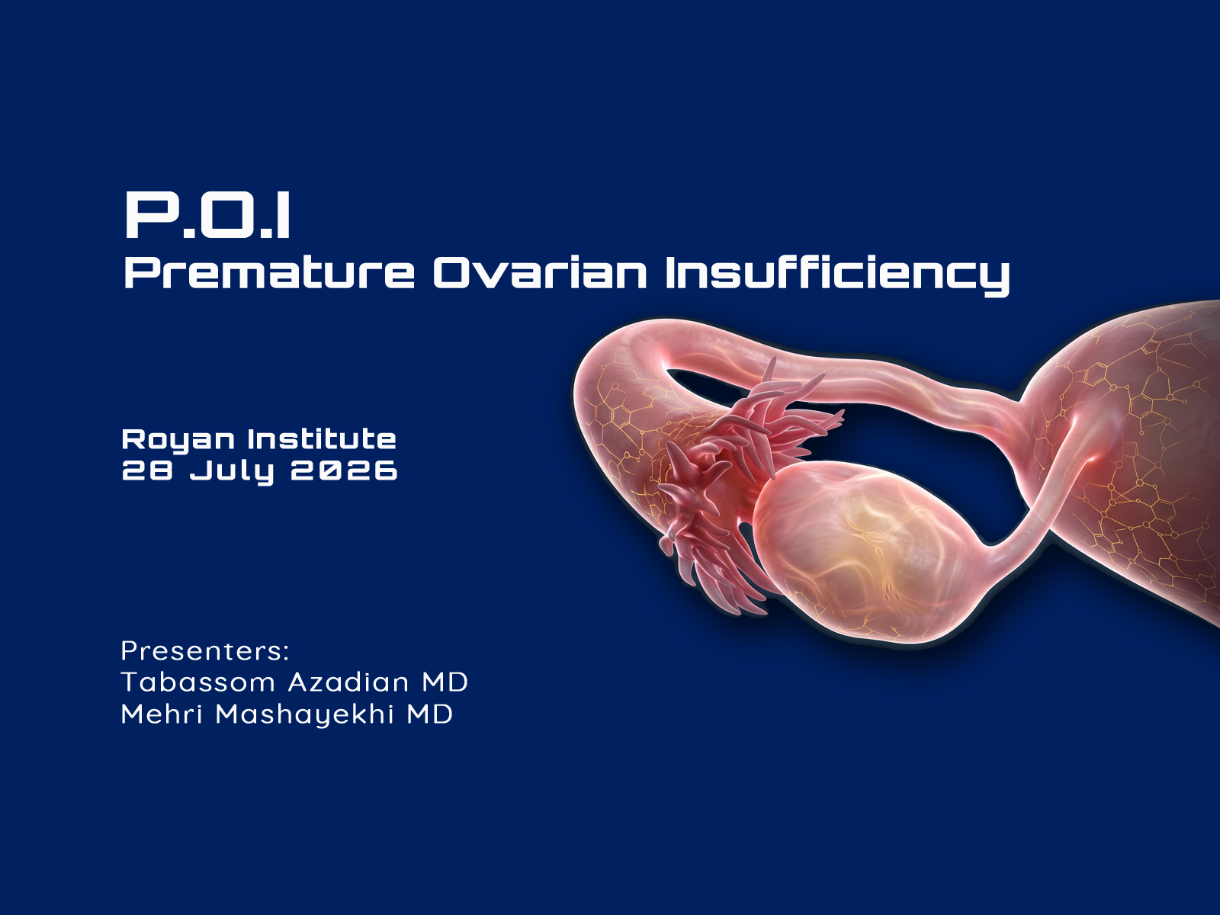

Slide 2
POI is a condition defined by loss of ovarian activity before the age of 40 years
POI is characterised by amenorrhea or irregular menstrual cycles with elevated gonadotropins and low Estradiol
The ESHRE Guideline Group On Ovarian Stimulation et al., 2020

Slide 3
Prevalence of POI
The reported prevalence of non-iatrogenic POI varies from approximately 1% in older studies to 3.5% in recent publications. Population characteristics such as ethnicity may affect the prevalence of non-iatrogenic POI
.
Li et al., 2023
Notes:
(Krailo and Pike, 1983, Coulam et al., 1986, Cramer and Xu, 1996, Luborsky et al.,
2003).
(Golezar et al., 2019)

Slide 4
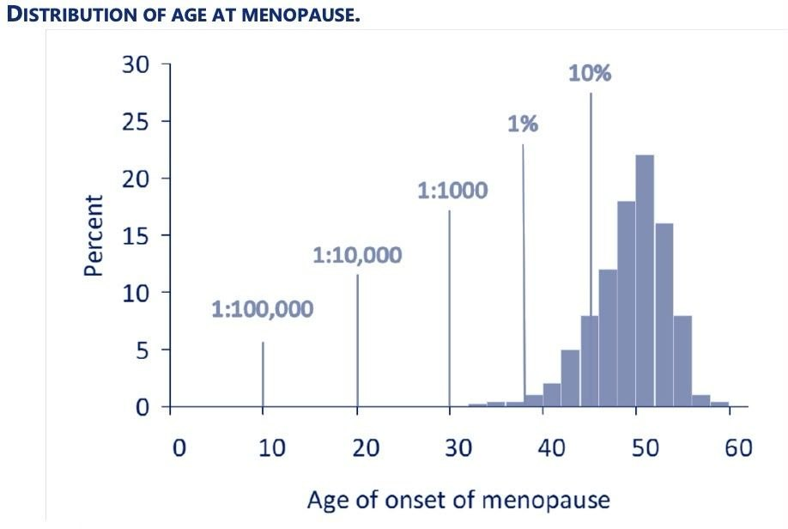
Distribution of Age at Menopause
A similar global overall prevalence of POI of 3.5% was reported in a more recent systematic review and
meta-analysis (Li et al., 2023). The prevalence of POI differed between regions globally, as well as
between developing and developed countries. In addition, the trend of prevalence of POI over the past
20 years appears to be on the rise (Li et al., 2023).

Slide 5
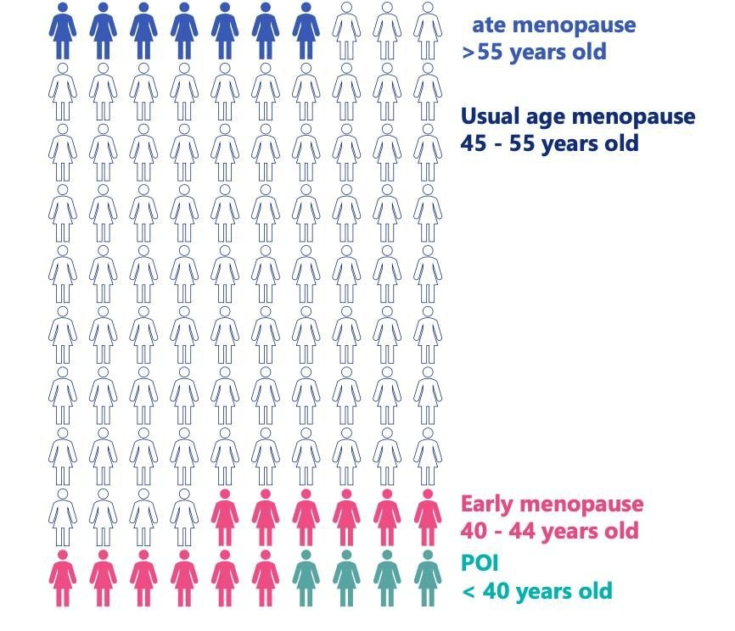
Distribution of Age at Menopause and Prevalence of Non-iatrogenic POI (Based on GOLEZAR ETAL.2019)

Slide 6
Iatrogenic POI
Bilateral oophorectomy has been practised at the time of hysterectomy for benign gynaecological disease.
Of current concern is the rising incidence of iatrogenic POI in young cancer survivors, consequent on the increasing success of cancer therapy
Iatrogenic POI may also arise from the increasing use of cytotoxic agents in treatment of serious non_malignant disease, such as cyclophosphamide for systemic lupus erythematosus /stem cell transplant for haemoglobinopathies or surgery for ovarian endometriosis
Erickson et al., 2022 / Rocca et al., 2023 / Coccia et al., 2011 / Huong et al., 2002, Katsifis and Tzioufas, 2004 / Rahal et al., 2018
Notes:
(Erickson et al., 2022)./ (Rocca et al., 2023).
(Gargus et al., 2018, Giri and Vincent, 2020)
(Huong et al., 2002 Katsifis and Tzioufas, 2004) / (Rahal et al., 2018) / (Coccia et al., 2011). /

Slide 7
Risk Factors for POI
.Genetic
Specific chromosomal abnormalities and genetic variants are associated with an increased risk of POI
.Family history and demographic factors
Multiple studies have identified family history as a strong predictor of the age at menopause
.Ethnicity
Usual age at menopause presents with a geographical variation as described previously, with the lower age in African, Asian, Latin American, and Middle Eastern countries
Silven et al., 2023 / Giri and Vincent, 2020 / Verrilli et al., 2023 / Luborsky et al., 2003

Slide 8
Early life factors
Early life Factors
Large cohort studies suggest a link between early life factors and the age of onset of natural menopause but data specific to POI is lacking.
Women whose mothers smoked during pregnancy had 24% higher odds for early menopause as compared to women whose mothers did not smoke.
Twin registry data indicated a higher prevalence of POI and early menopause in twins compared with the general population.
One small study observed an increased prevalence of POI in those born at gestation<37 weeks compared with controls
Neonatal and early childhood factors which have been associated with an earlier age at menopause Lower early childhood socioeconomic
Longer duration of breastfeeding was associated with a lower risk of early menopause in the Nurses’ Health Study II cohort study
Adverse parenting or childhood experiences were associated with an earlier age at menopause
Peycheva et al., 2022 / Sadrzadeh et al., 2017 / Giri and Vincent, 2020
Notes:
(Giri and Vincent, 2020 / (Gosden et al., 2007). / (Peycheva et al., 2022)

Slide 9
Reproductive Factors
Risk was further increased with the combination of nulliparity and early menarche
Data are conflicting regarding a possible association between POI or early menopause and earlier age at menarche.
A meta-analysis including 17 observational studies, reported that previous/ever use of the combined oral contraceptive pill (COC) was associated with later age at natural menopause
a case-control study of 553 women with POI and 400 controls reported an increased risk of POI associated with a history of pelvic surgery
Roman Lay et al., 2020 / Prince et al., 2022 / Mishra et al., 2017 / van Noord et al., 1997, Otero et al., 2010, Wang et al., 2015, Whitcomb et al., 2018a
Notes:
(Wang et al., 2015). / (Roman Layet al., 2020)./ (Mishra et al., 2017).
(Tao et al., 2015). /(Chemaitilly et al.,
2017).

Slide 10
Body Mass Index
Data from a 2015 meta-analysis indicated that lower body mass index (BMI) <18.5 was associated with an earlier age at natural menopause compared with women with normal BMI
Socio-economic Status
Based on 11 studies, a 2014 meta-analysis reported that onset of menopause was later in women with middle (higher school certificate/diploma) and higher (university or higher degree) education levels, compared to in women with lower education
More recently, a Finnish study indicated that women with POI had lower socio-economic status and levels of education compared with the general population
Chemaitilly et al., 2017 / Silvén et al., 2022 / Peycheva et al., 2022 / Jungari and Chauhan, 2017

Slide 11
Smoking
Multiple studies have linked smoking to an earlier age of natural menopause
Alcohol
Consumption seems to be inversely associated with age at natural menopause. Data from alarge prospective study suggest a weak association of moderate alcohol intake
Infectious Causes
POI has been reported following various infections, including mumps, HIV, herpes zoster, cytomegalovirus, tuberculosis, malaria, varicella, and shigella
However, only mumps oophoritis has been considered a cause of POI, explaining 3 to 7% of women POI a 2022 study of 3059 US women living with or at risk of HIV reported a prevalence of POI and early menopause similar to that reported globally
Kato et al., 1998, Schoenaker et al., 2014, Oboni et al., 2016, Zhu et al., 2018a, Ruth et al., 2021 / Peycheva et al., 2022 / Wang et al., 2015
Notes:
(Freeman et al., 2021). / (Peycheva et al., 2022). / (Goswami and Conway, 2005, Kokcu, 2010) / (Wang et al., 2015) / (Bullington et al., 2022).
.

Slide 12
Coexisting Medical Conditions
A recent population-based study of women with PCOS (n=7049) and women without PCOS (n=70490) reported that the risk for POI was significantly higher in women with PCOS than controls
Galactosemia is an inherited metabolic disorder that affects about 1 in 50000 live births in the United States. In a recent cohort study of 102 post-pubertal girls and women with galactosemia, only 68% achieved spontaneous menarche; fewer than 50% of these women were still cycling regularly after 3 years, and fewer than 15% were cycling regularly after 10 years
Autoimmune disease, especially Addison’s disease, has also been associated with an increased risk of POI
Frederick et al., 2018 / Pan et al., 2017
Notes:
(Bullington et al., 2022). / (Goswami and Conway, 2005, Kokcu, 2010). / (Wang et al., 2015). /(Frederick et al., 2018).

Slide 13
Chemical Exposures
Exposure to endocrine disruptors also appears to impact the usual age of menopause. Examples of endocrine disrupting chemicals heavy metals such as cadmium, thallium, and arsenic, persistent organic pollutants
In a series of case-control studies comparing a group of Chinese women with POI (defined as age <40, oligomenorrhoea or amenorrhea for at least 4 months, and an elevated FSH level > 25 IU/L on two occasions > 4 weeks apart) to control women, serum and/or urinary levels of multiple EDCs were associated with significantly increased odds for POI
Zhu et al., 2024 / Pan et al., 2019Ye, 2020 #2438, Cao et al., 2020, Pan et al., 2020, Pan et al., 2021, Ma et al., 2022
Notes:
(Torella et al., 2023). / (Naleway et al., 2018). / (Dinget al., 2020). / (Zhu et al., 2024 )

Slide 14
Vaccines
A 2023 meta-analysis, which included four studies and a total of 1 253 758 female children and adolescents, found no increased risk for POI after quadrivalent HPV vaccination, as well as no increased risk with quadrivalent HPV vaccines relative to bivalent and 9-valent vaccines
Cohort studies have also found no association between POI and other vaccines, including the tetanus, diphtheria, and pertussis (Tdap), inactivated influenza, and meningococcal vaccines
Circulating Factors as POI Biomarkers
Various circulating factors have been shown to be altered in women with POI in small studies, including vitamin E, trace elements, co-enzyme Q10 ,certain gut microbiota ,CD4+ T-cells ,neutrophil to lymphocyte ratios, inducible nitric oxide synthase ,insulin-like peptide 3, and IFN-γ. However, whether these circulating factors are relevant to the pathogenesis of POI, or can serve as novel biomarkers, has not been established.
Tatang et al., 2022 / Torella et al., 2023 / Patricia Wodi et al., 2023 / Naleway et al., 2018 /Verma et al., 2018 / Ma et al., 2023 / Yldrm et al., 2015, Ağaçayak et al., 2016 / Tokmak et al., 2015

Slide 15
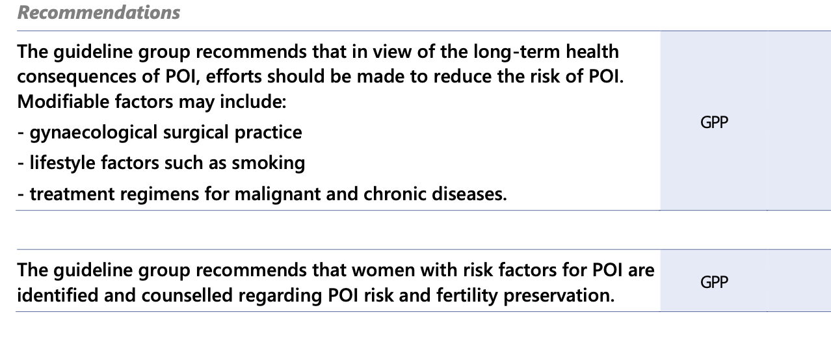
Recommendations

Slide 16
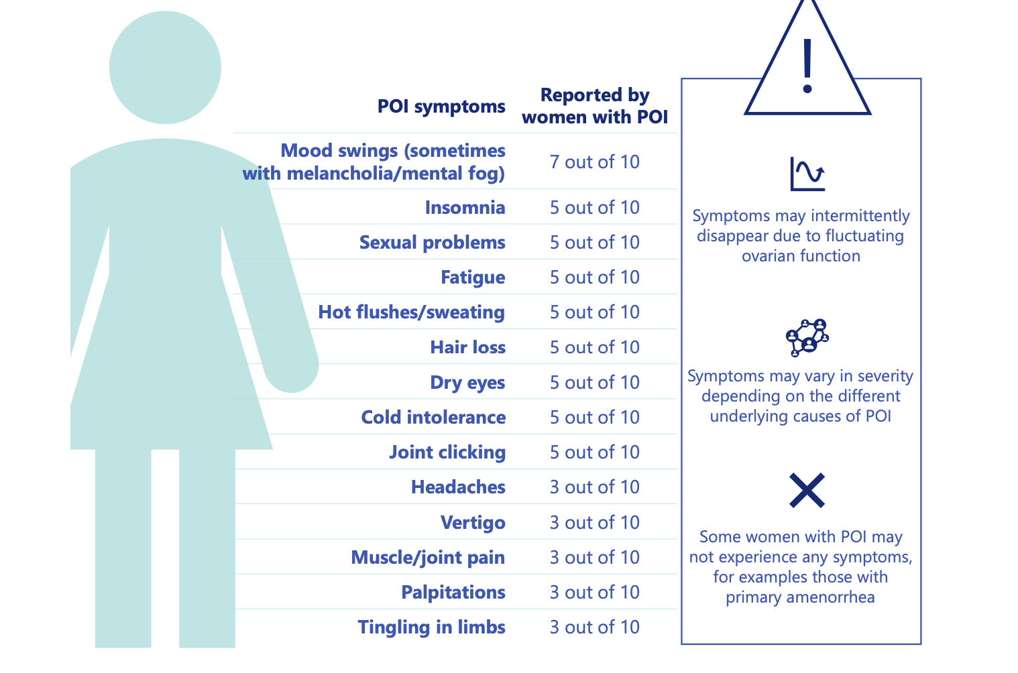
Symptoms
Notes:
(ALLSHOUSE ET AL., 2015, HUANG ET AL., 2021)
(ALLSHOUSE ET AL., 2015, HUANG ET AL., 2021)

Slide 17
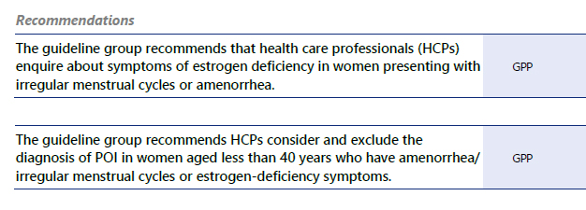
Recommendations

Slide 18
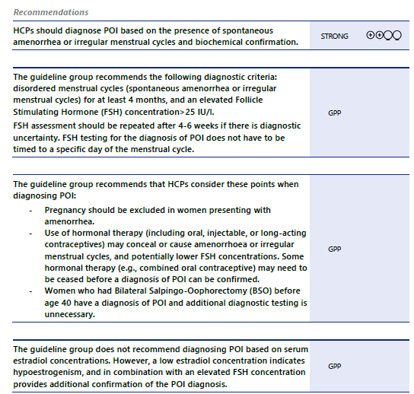
Diagnosis
NICE, 2015, NICE, 2019 /

Slide 19
What Is The Role Of AMH to Predict/ Diagnose POI?
Anti-Müllerian hormone (AMH) should not be used as the primary diagnostic test for POI.
The guideline group recommends that HCPs do not routinely perform AMH testing to predict POI due to insufficient evidence of accuracy.
The ESHRE Guideline Group On Ovarian Stimulation et al., 2020 / Nelson et al., 2023 / Anderson et al., 2022a / Iwase et al., 2024
Notes:
(Anderson et al., 2022b) /

Slide 20
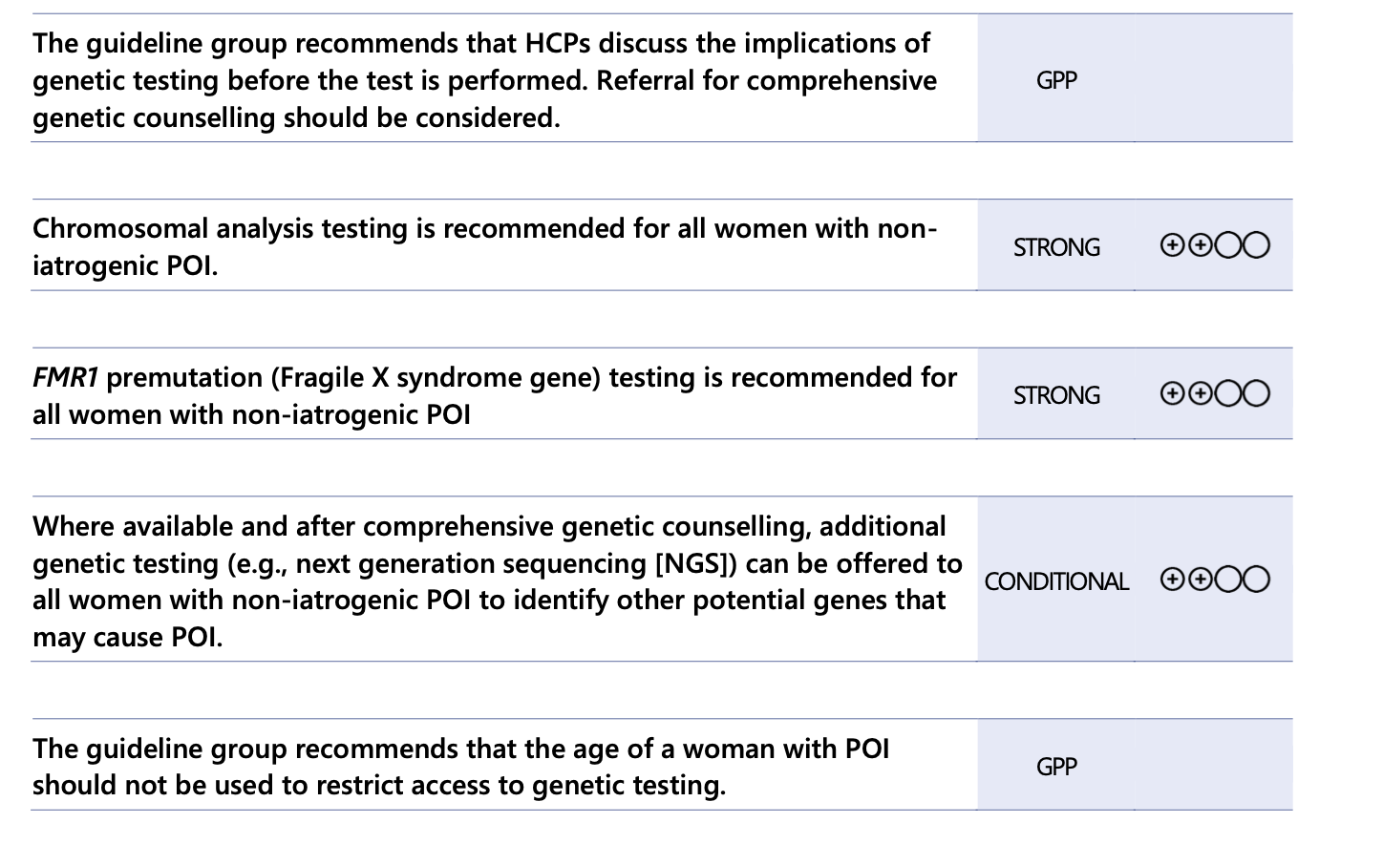
Genetic Background of POI
Notes:
(Tšuiko et al., 2016, Di-Battista et al., 2020, Bestetti et al., 2021). / (Poteet et al., 2023). / (Hunter JE. et al., 2019). / (Richards et al., 2015) / (Christin-Maitre et al., 2021)./
(Heddar et al., 2022, Ke et al., 2023).

Slide 21
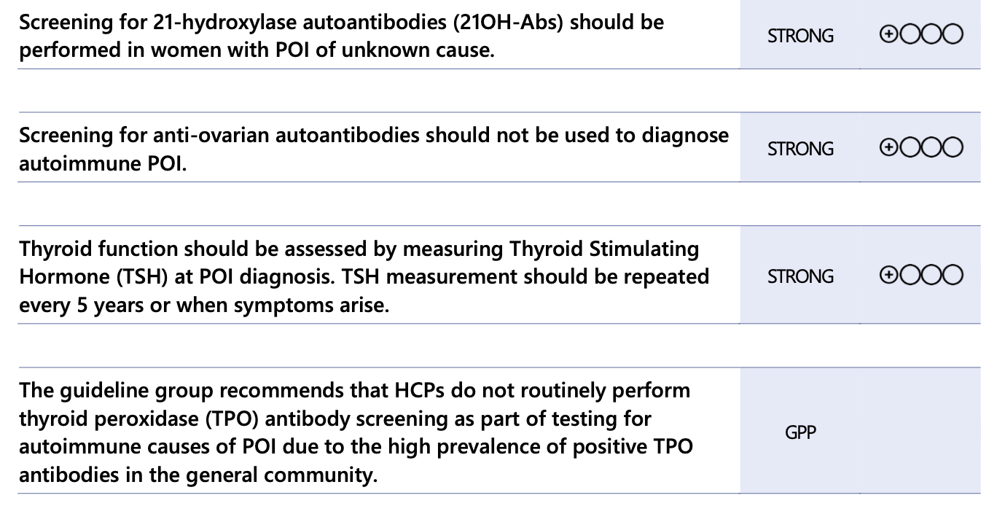
What Are the Known Autoimmune Causes of Non-iatrogenic POI and How Should They Be Investigated?
Walker et al., 2019

Slide 22
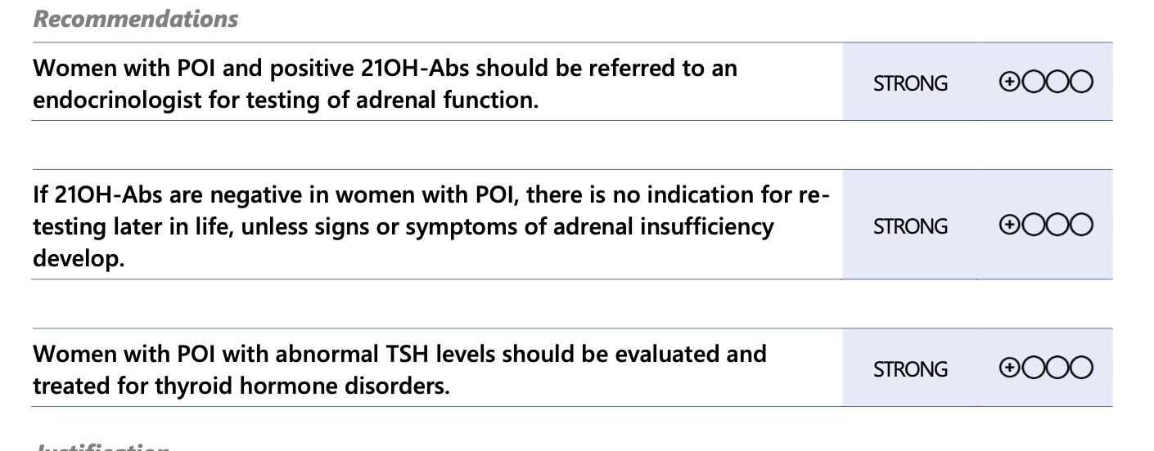
How often Should Tests for Autoantibodies Be Repeated?
Vogt et al., 2021 / Husebye et al., 2021
Notes:
(Silva et al., 2014, Kirshenbaum and Orvieto, 2019)/(Vogt et al., 2021)./(Li et al., 2022, Tanska et al., 2022)/ (Husebye et al., 2021)/
/

Slide 23
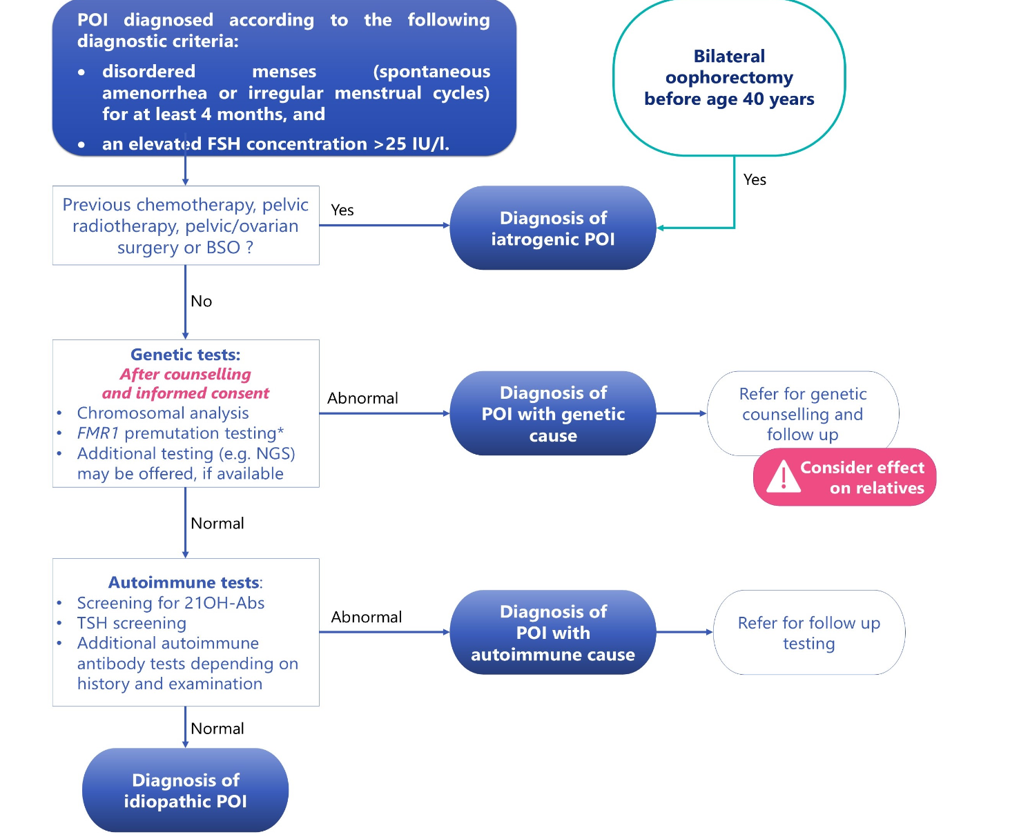
Summary of the Recommendations On Diagnosis and Testing To Establish A Cause for POI

Slide 24
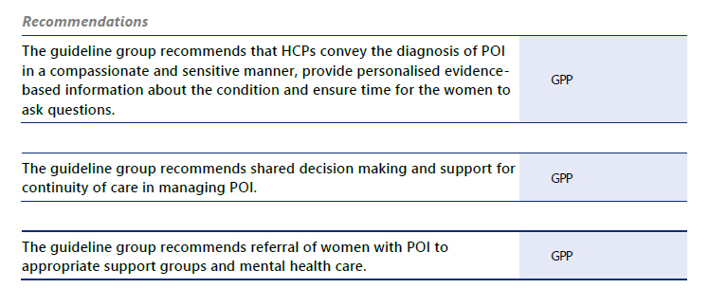
Care for women with POI at diagnosis
McDonald et al., 2022, Vincent et al., 2024

Slide 25
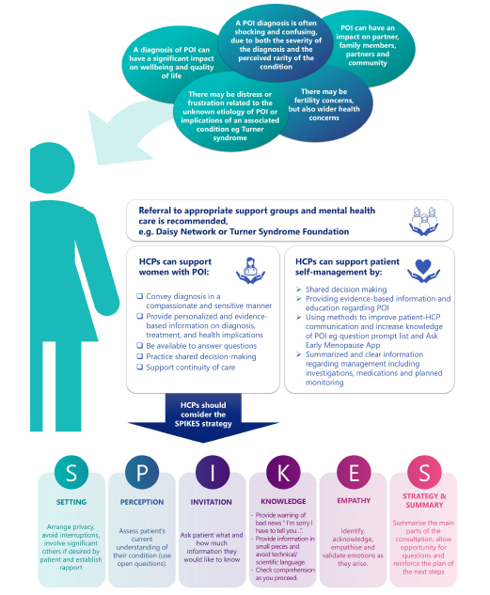

Slide 26
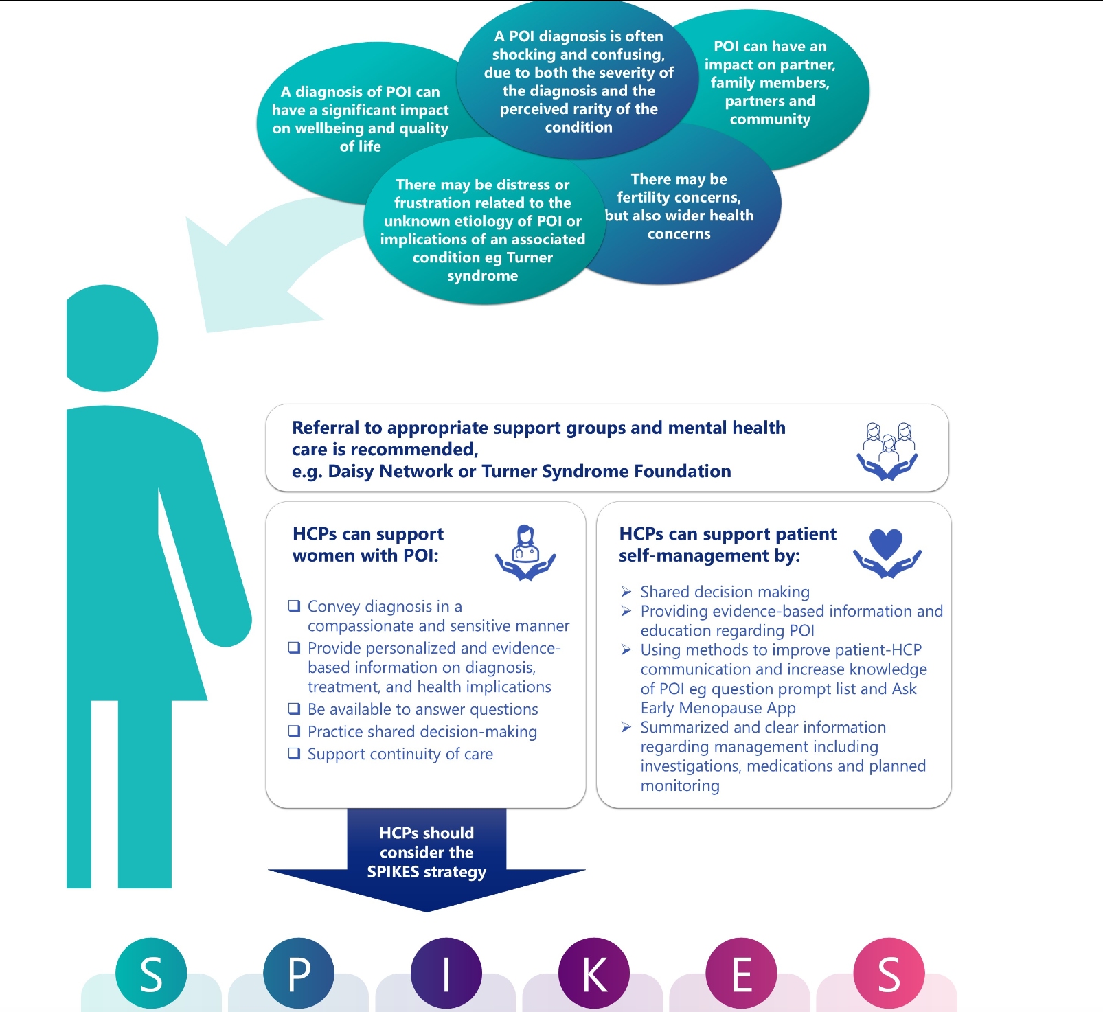

Slide 27
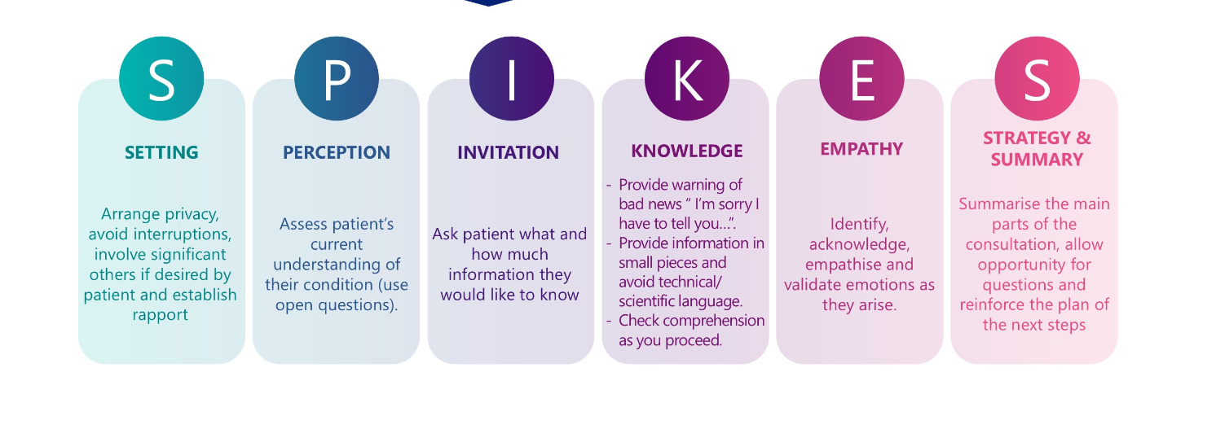

Slide 28
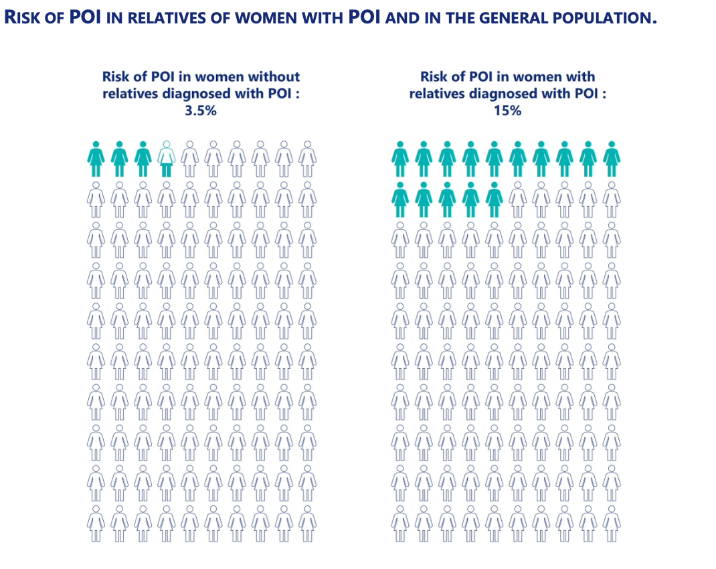
Verrilli et al., 2023 / Golezar et al., 2019, Li et al., 2023 / Webber et al., 2016

Slide 29
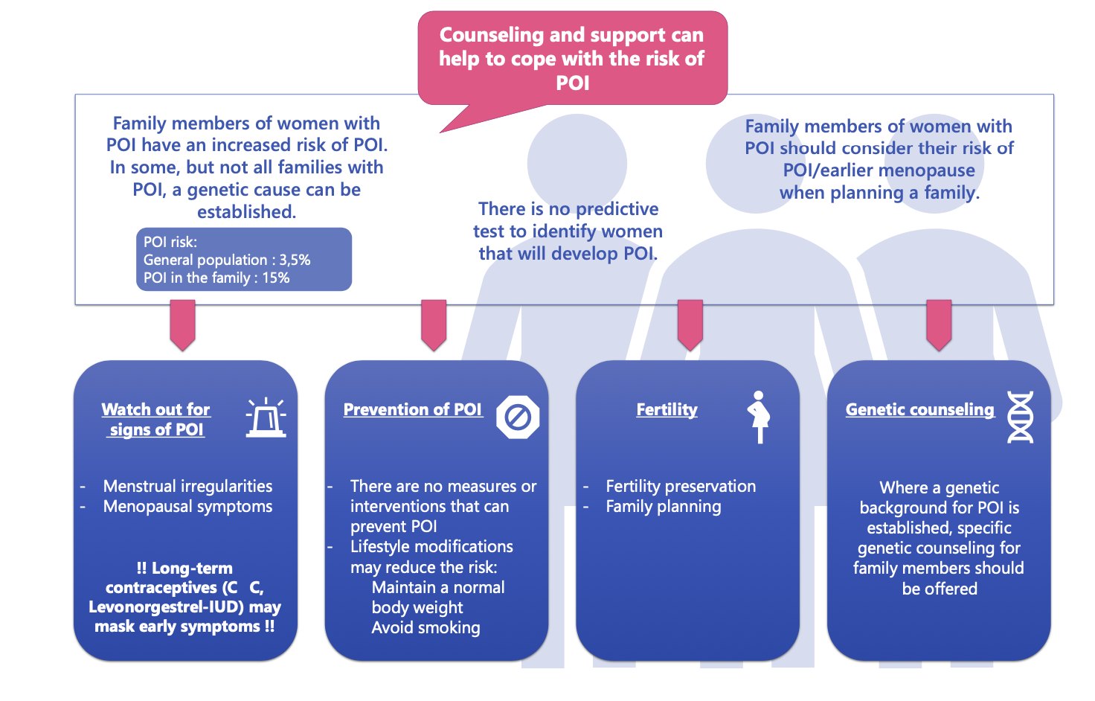
Summary of Information for Family Members of Women with POI
Verrilli et al., 2023 / Golezar et al., 2019, Li et al., 2023 / Barros et al., 2020

Slide 30
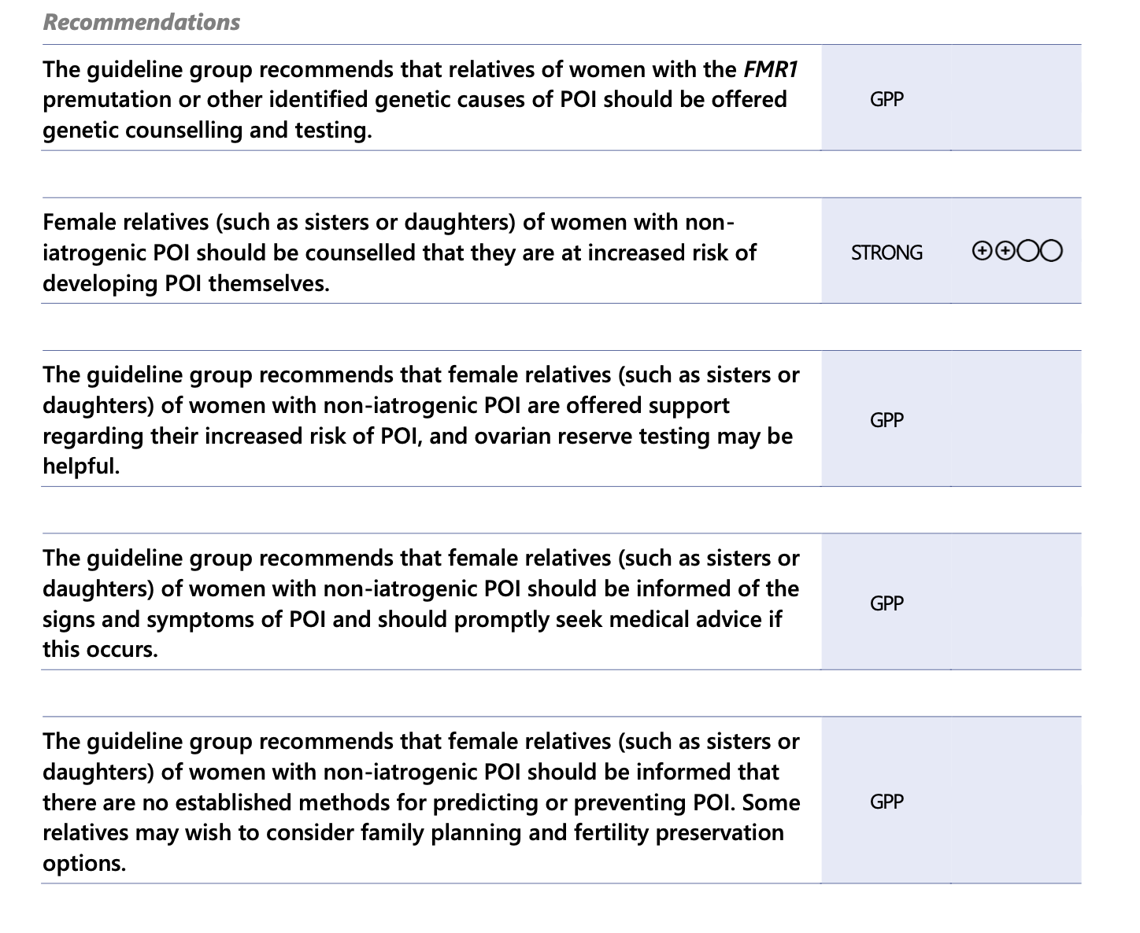
Notes:
(La Marca and Mastellari, 2021) / (Silvén et al., 2022)./(Verrilli et al., 2023).

Slide 31
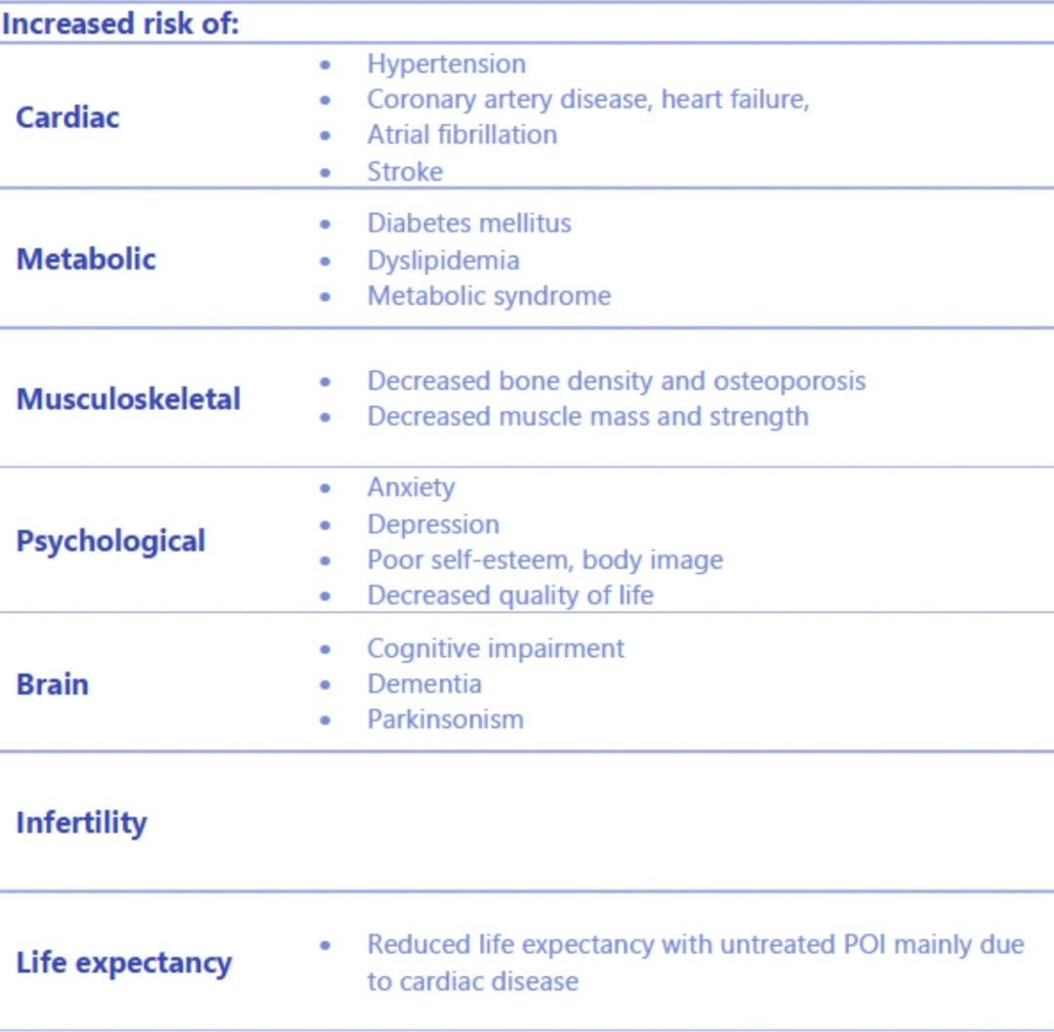
Long Term Consequences

Slide 32
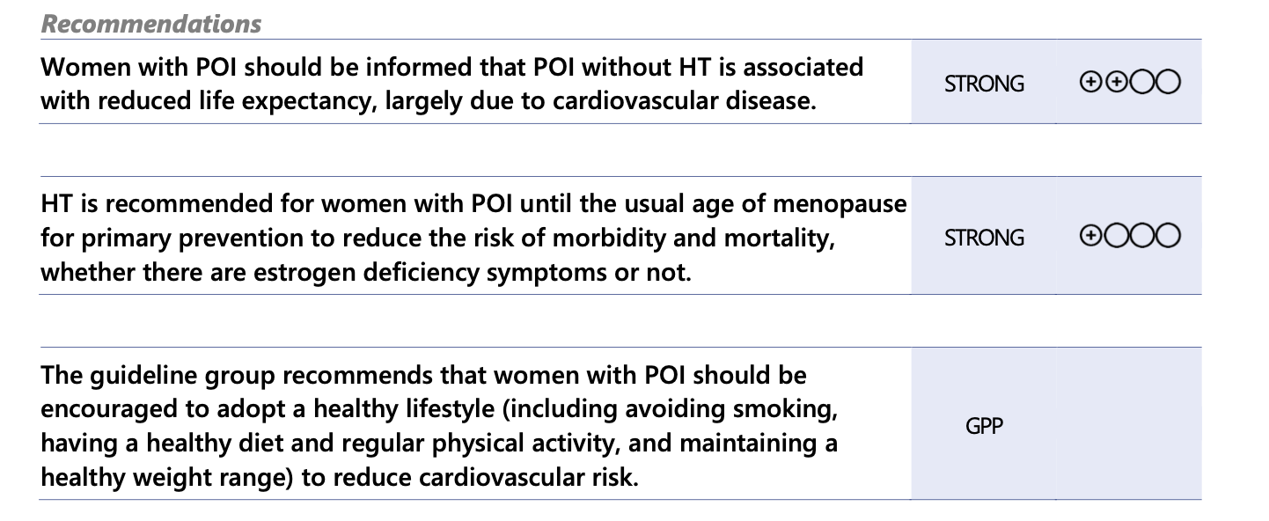
What Are the Consequences of POI For Life Expectancy?
Rocca et al., 2023
Notes:
(Kaunitz et al., 2021, Rocca and Faubion, 2022). /

Slide 33
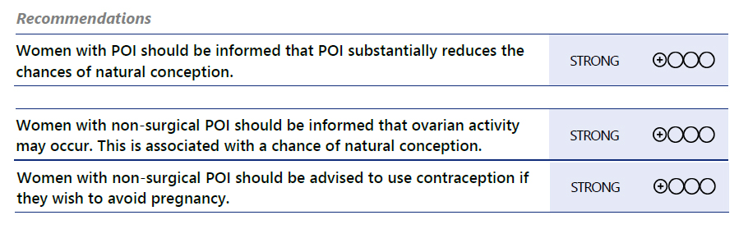
Fertility and Fertility Treatments
Recommendations
Bachelot et al., 2017, Fraison et al., 2019 / Cambray et al., 2023
Notes:
(Bachelot et al., 2017) / (Bachelot et al.,
2017, Fraison et al., 2019, Cambr ay et al., 2023)./ (Bachelot et al.,
2017, Fraison et al., 2019, Cambray et al., 2023).//. (Bachelot et al.,
2017, Fraison et al., 2019, Cambray et al., 2023)./(Bachelot et al.,
2017, Fraison et al., 2019, Cambray et al., 2023).//(Bachelot et al.,
2017, Fraison et al., 2019, Cambray et al., 2023).
v(Bachelot et al.,
2017, Fraison et al., 2019, Cambray et al., 2023).
(Bachelot et al.,
2017, Fraison et al., 2019, Cambray et al., 2023).// (Cambray et al., 2023)./(Bachelot et al.,
2017, Fraison et al., 2019, Cambray et al., 2023).

Slide 34
What Fertility Interventions Are Effective?
1. In vitro activation of follicle growth in biopsied ovarian tissue.
2. Administration of mesenchymal stem cells.
3. Injection of platelet rich plasma into the ovary.
Rosario and Anderson, 2021, Zhang et al., 2021 / Pellicer et al., 2023 / Tinjić et al., 2021 /Cakiroglu et al., 2020 / Herlihy et al., 2023
Notes:
(Tinjić et al., 2021)./ (Kawamura et al., 2016), / (Cakiroglu et al., 2020) / (Ferreri et al., 2020),/ (Ferreri et al., 2020),

Slide 35
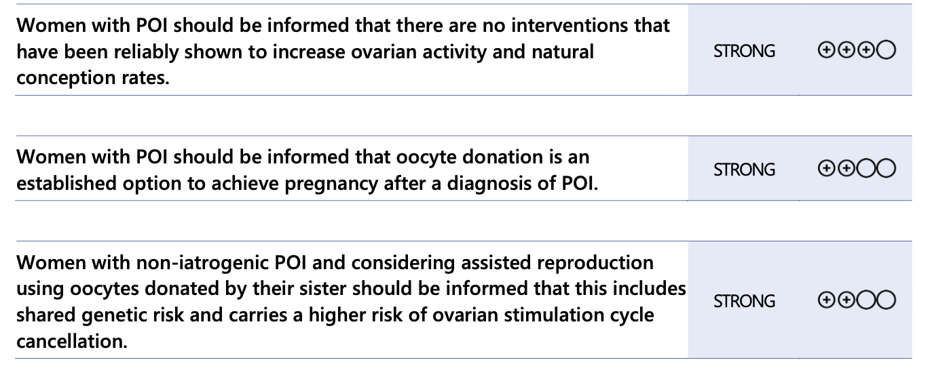
Oocyte Donation to Achieve Pregnancy
Sauer et al., 1994, Templeton et al., 1996 / Hogan et al., 2019

Slide 36
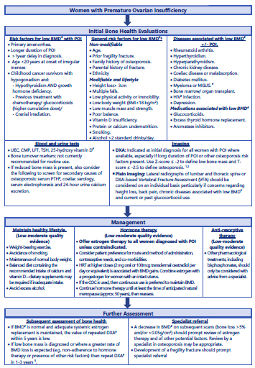
Management Algorithm For Bone Health In Women With Premature Ovarian Insufficiency
(POI) (Adapted From (Kiriakova Et Al., 2019), Reproduced With Permission)

Slide 37
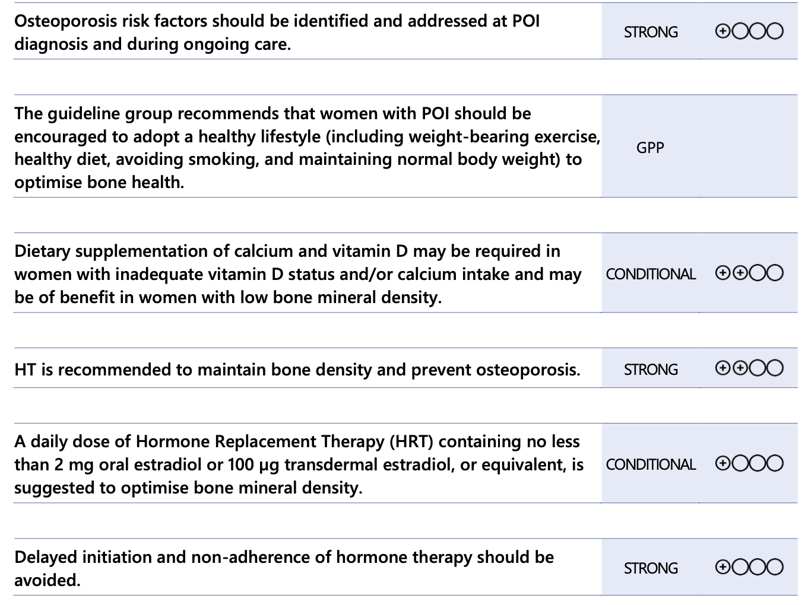
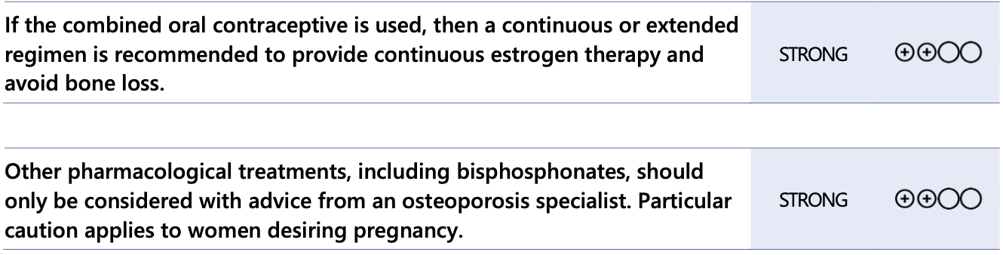
Bone Protection and Improvement
Shapiro et al., 2011, Waqas et al., 2021 / Ebeling et al., 2022/ Stathopoulos et al., 2011/ Schreiber et al., 2023

Slide 38
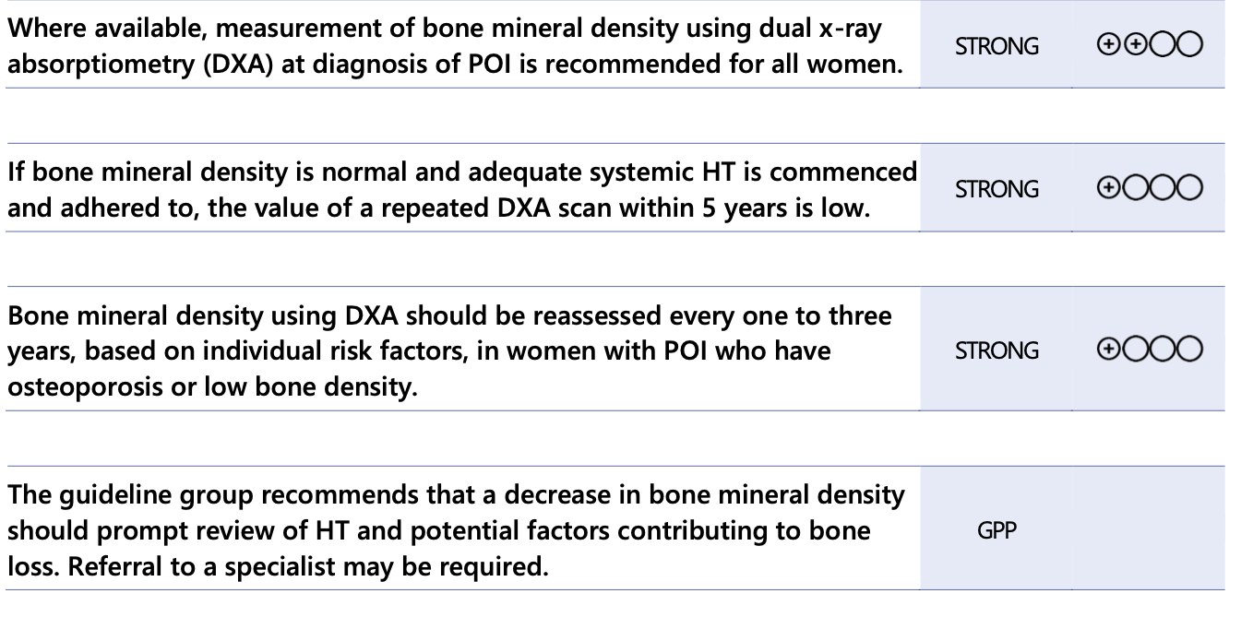
Monitoring of Skeletal Health
Eastell et al., 2019, Kanis et al., 2019, Camacho et al., 2020, de Villiers and Goldstein, 2021, International Society for Clinical Densitometry, 2023

Slide 39
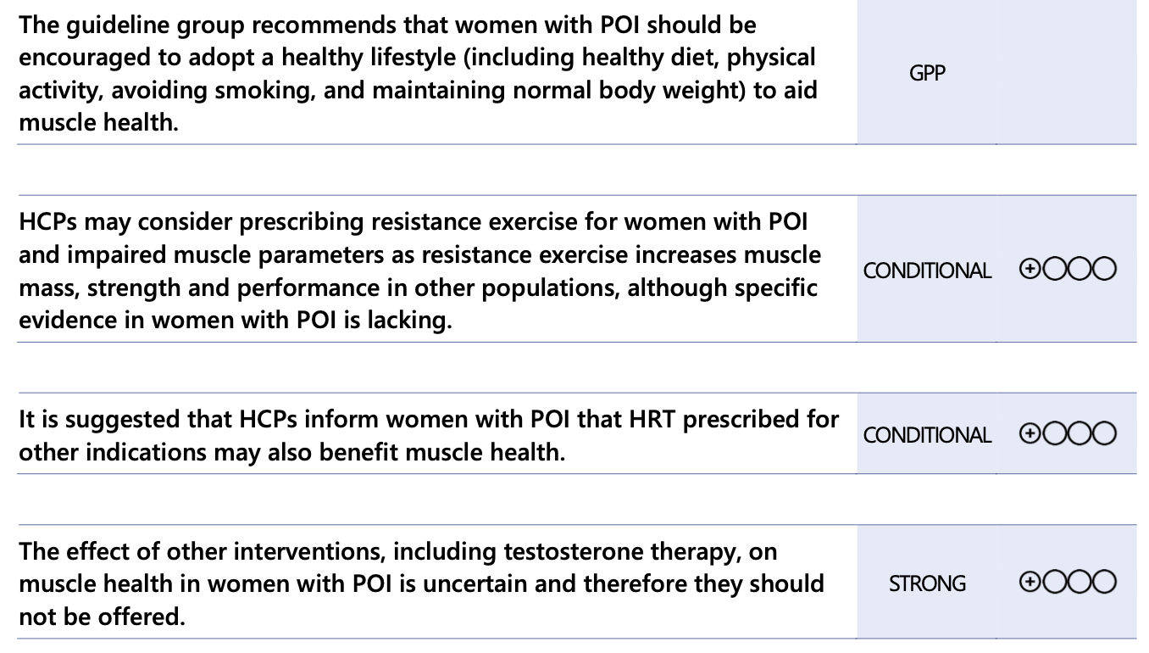
Muscle Health Protection and Improvement
Price et al., 2023 / Gravholt and Backeljauw, 2017, Samad et al., 2020
Notes:
(Thomas et al., 2021, Sá et al.,2023 / (Price et al., 2023)

Slide 40
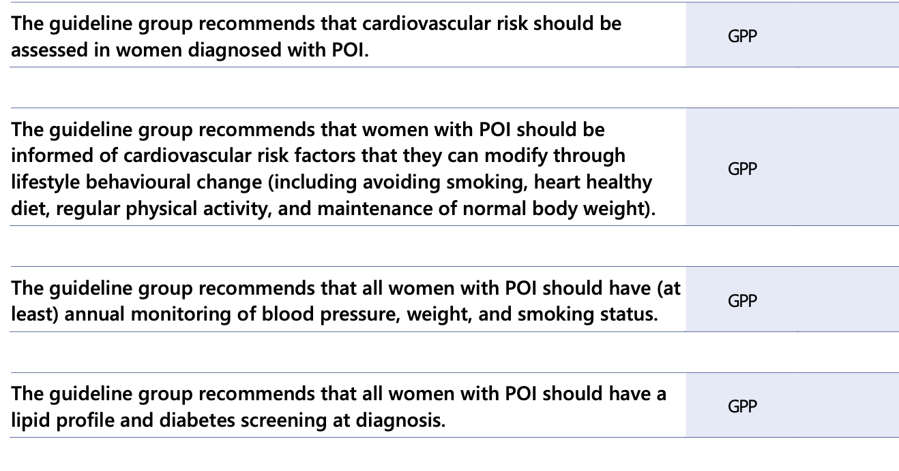
Monitoring of Cardiovascular Risk Factors
Mehta and Manson, 2024 /Gravholt et al., 2023

Slide 41
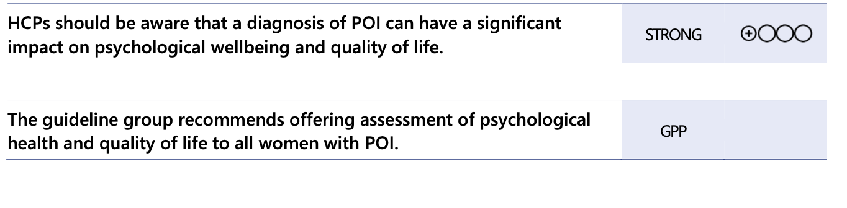
POI and Psychological Wellbeing
Yeganeh et al., 2020a /Chu et al., 2021/McDonald et al., 2022

Slide 42
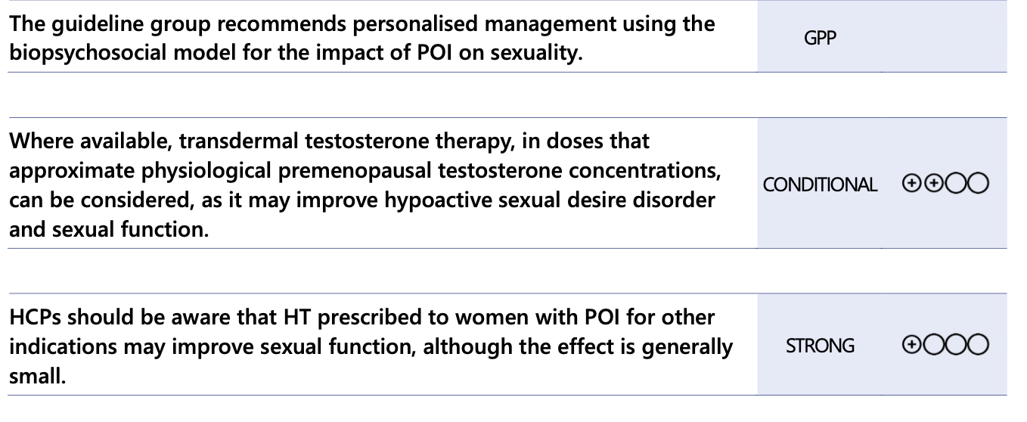
POI and Sexuality
Dedden et al., 2023/Morgan et al., 2023/Tucker et al., 2021

Slide 43
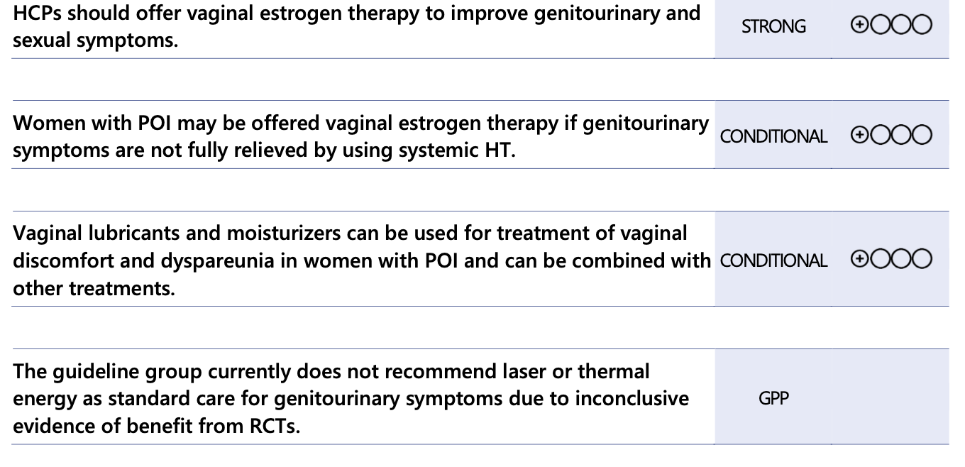
Treatment of Genitourinary Symptoms Associated with Menopause
Palacios et al., 2023a / Christmas et al., 2023/Staller et al., 2017

Slide 44
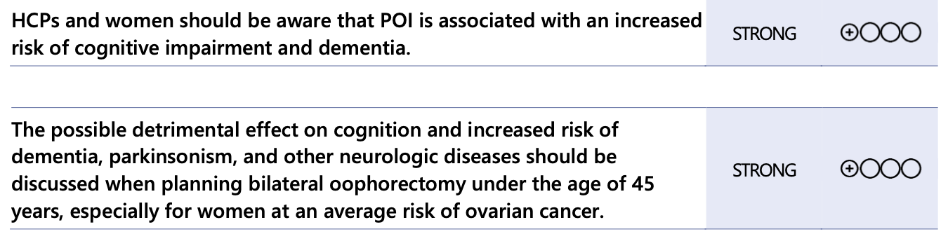
POI and Neurological Function
Ryan et al., 2014, Hao et al., 2023

Slide 45
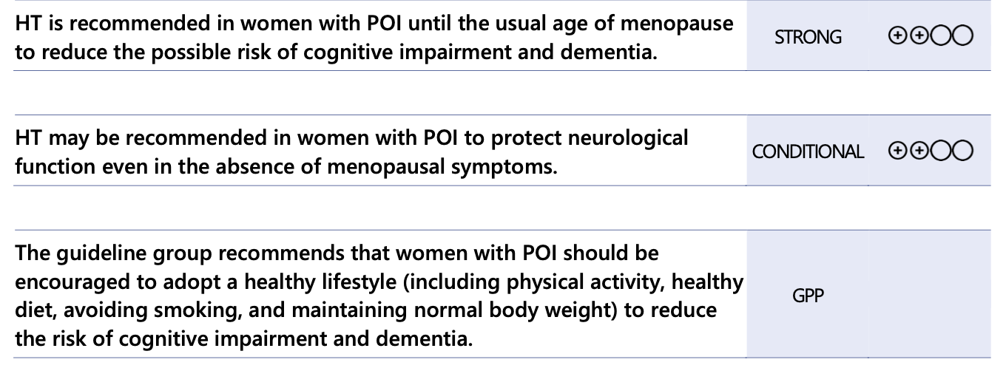
What Are the Management Options For the Effect of POI on Cognition/Neurological Function?
Blümel et al., 2022 / Rocca et al., 2021b

Slide 46
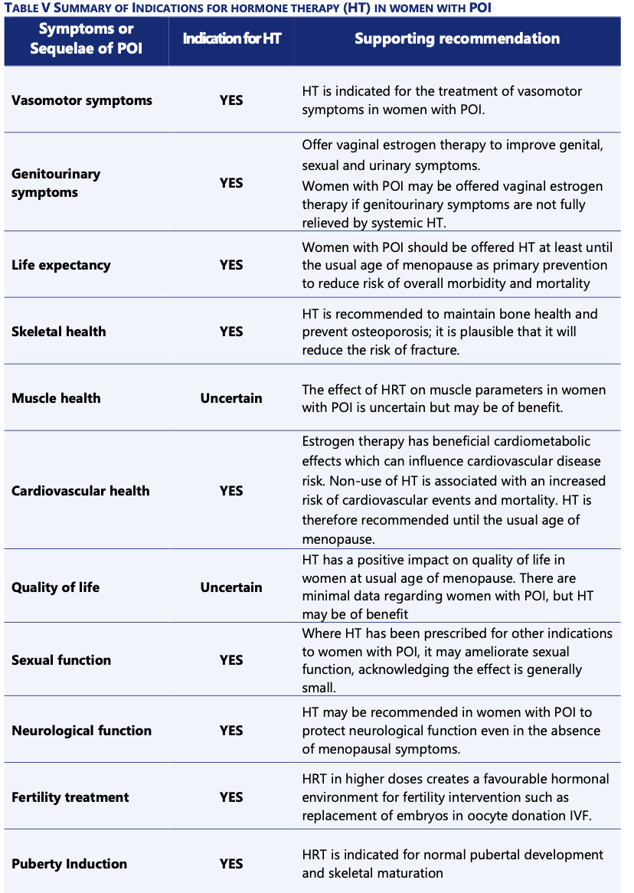

Slide 47
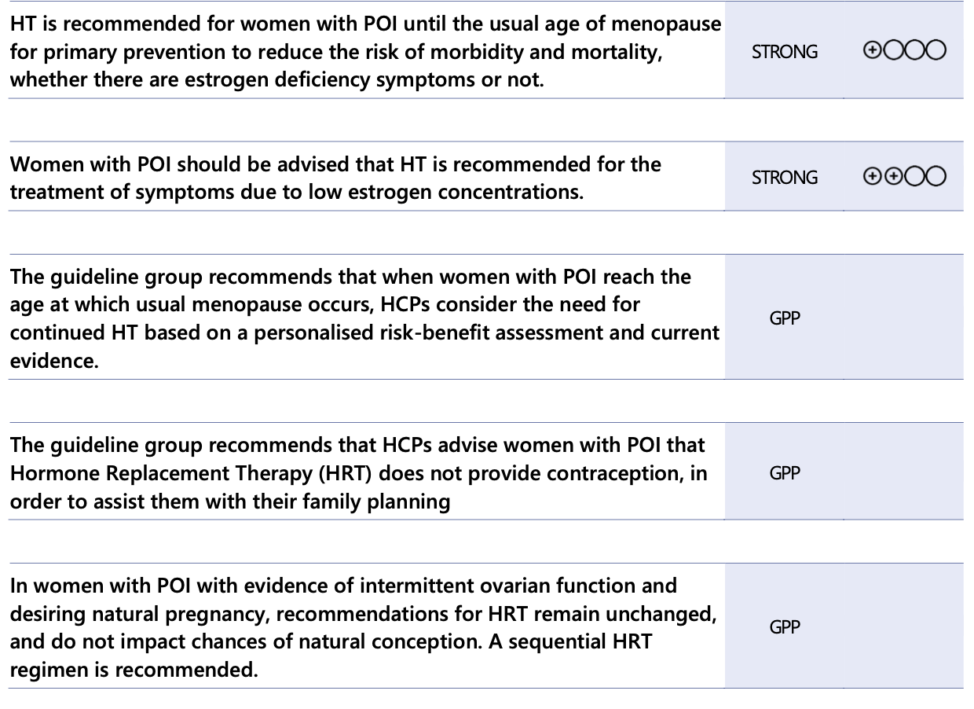
POI Treatment
Yeganeh et al., 2020a /Chu et al., 2021/McDonald et al., 2022

Slide 48
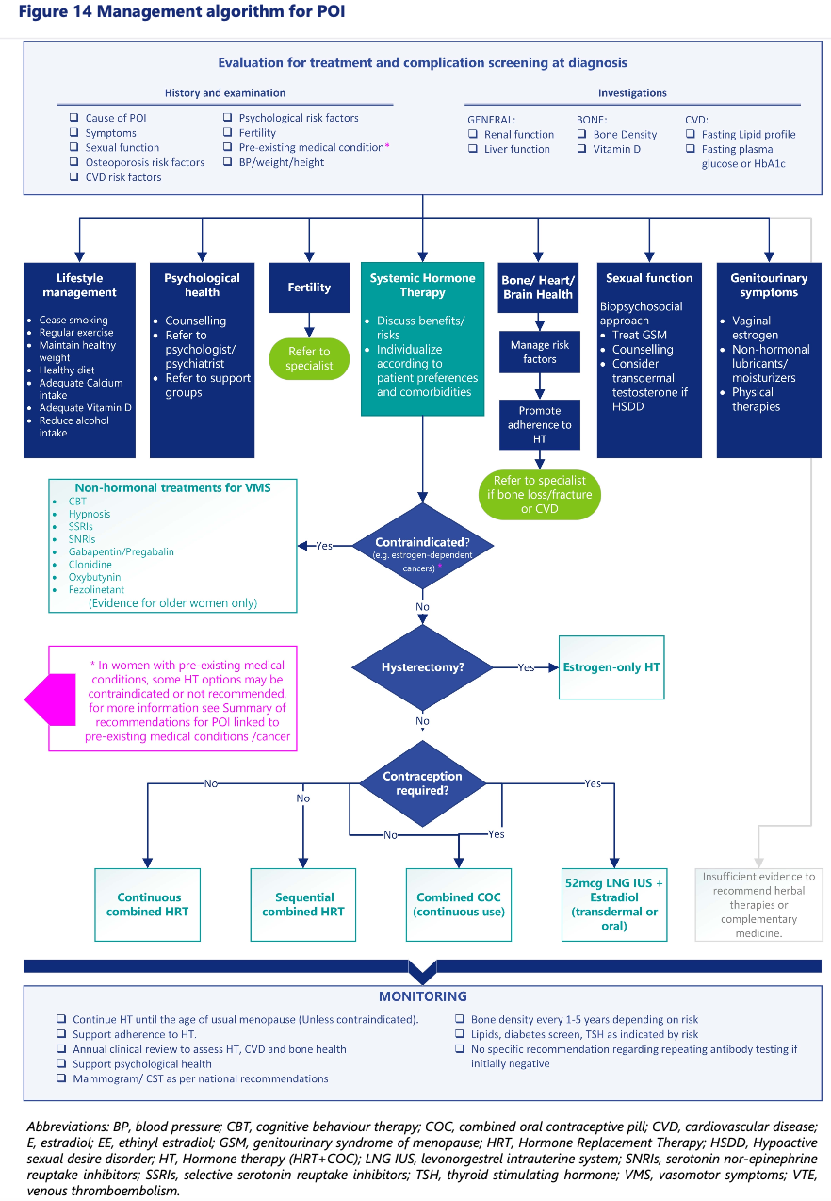

Slide 49
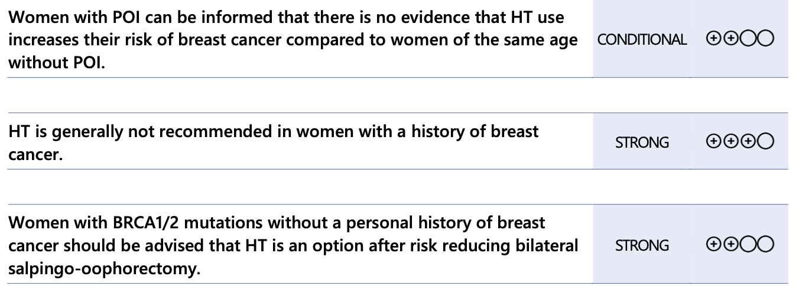
HT Regimens and Breast Cancer Risk
Marchetti et al., 2771, Gordhandas et al., 2019, Vermeulen et al., 2019 2959 / Collaborative Group on Hormonal Factors in Breast Cancer., 2019

Slide 50
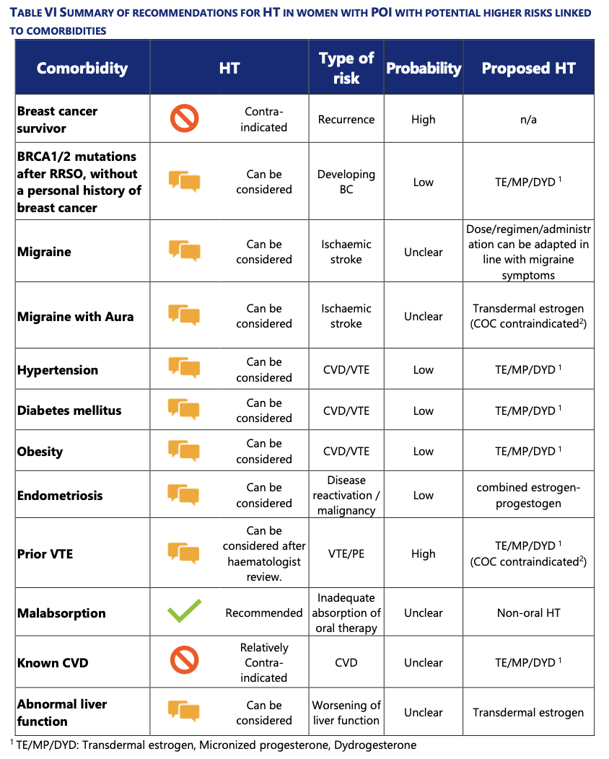

Slide 51
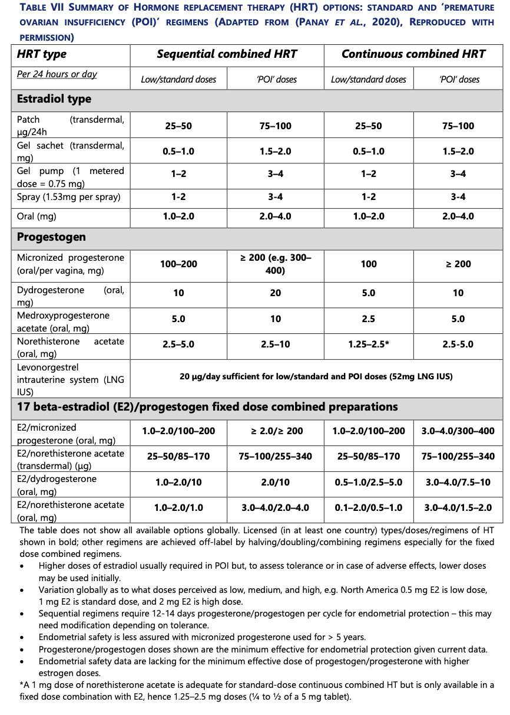

Slide 52
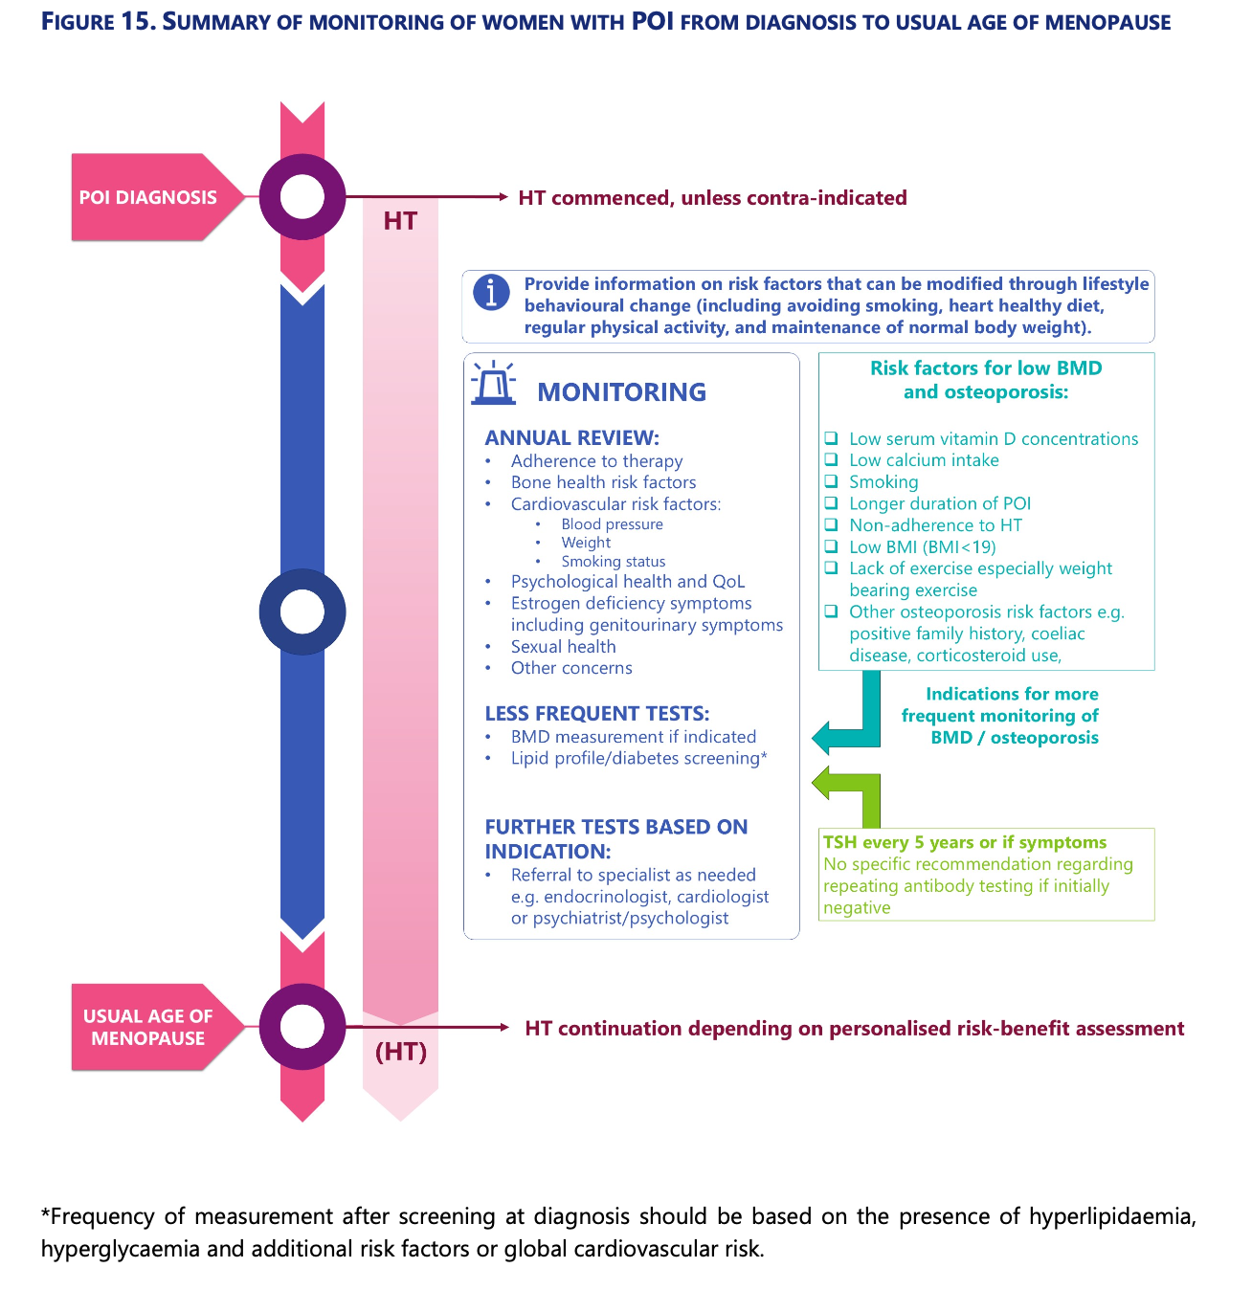

Slide 53
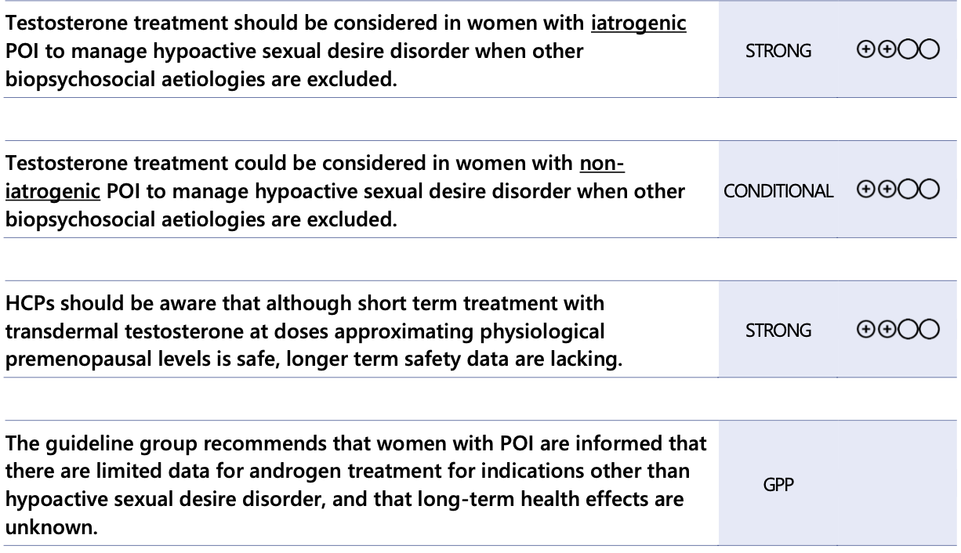
What Is The Role Of Testosterone Therapy In POI?
Soman et al., 2019 / Shiraishi et al., 2008, Labrie et al., 2011/ Davis et al., 2019/ Sultana et al., 2023b

Slide 54
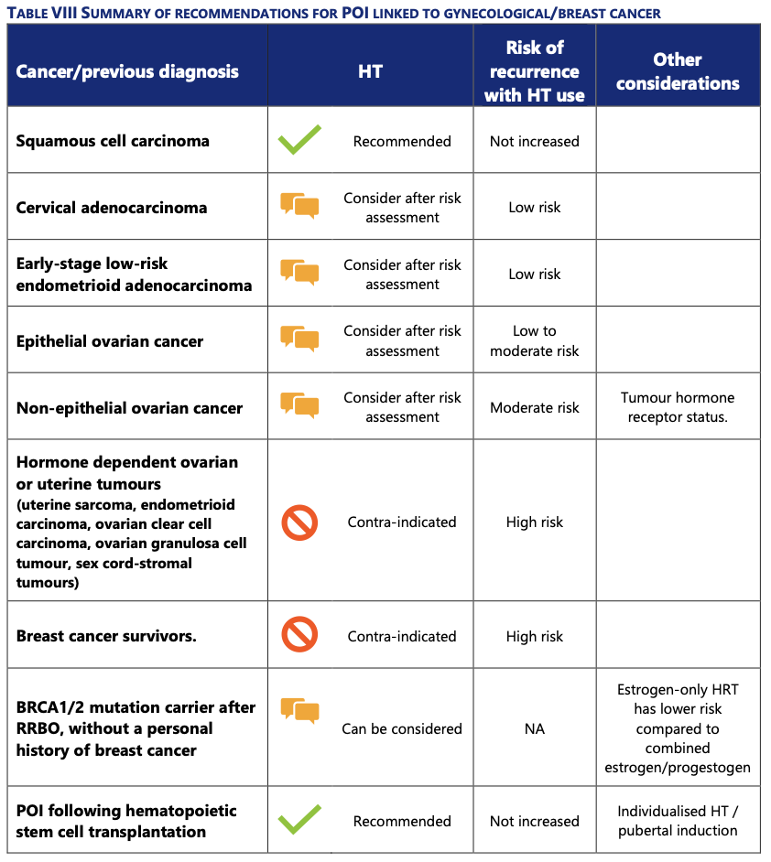

Slide 55
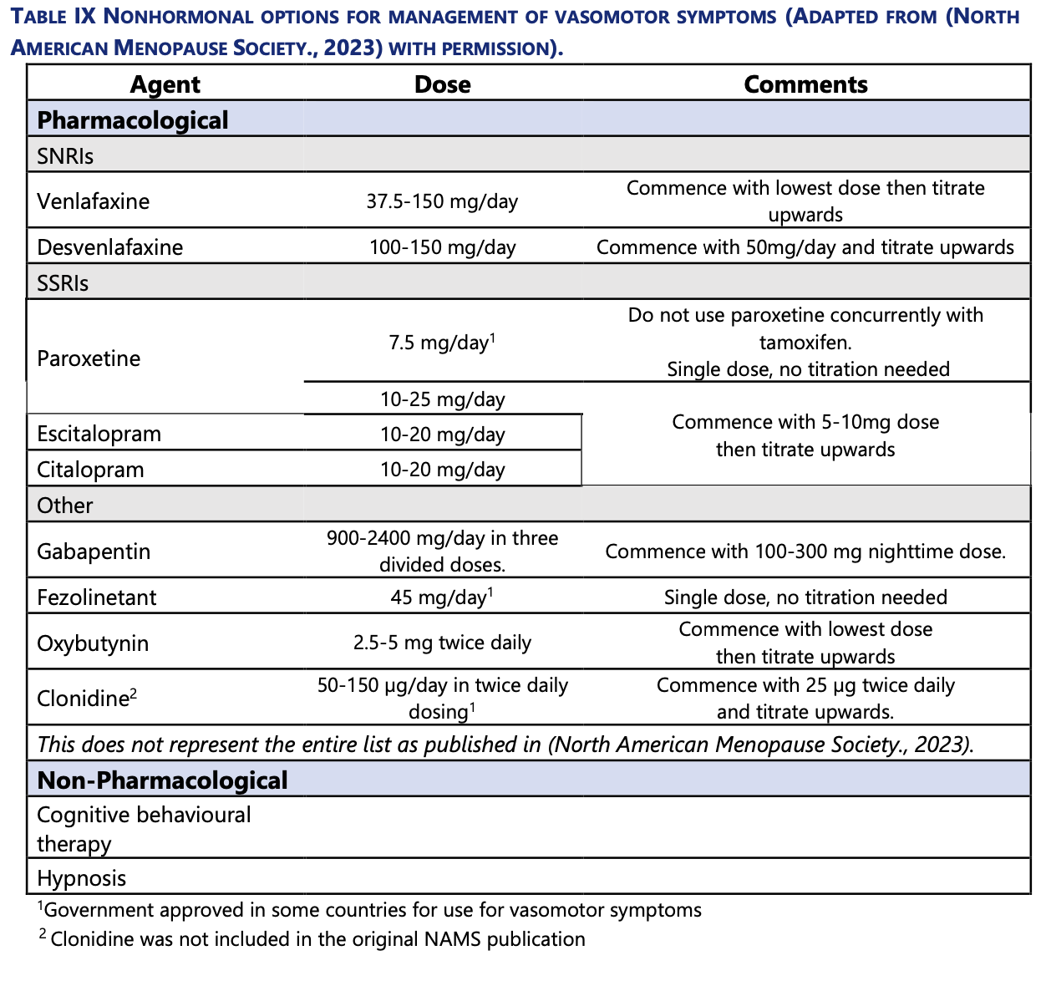
Cheng et al., 2020 /Caan et al., 2015, Ensrud et al., 2015 / Liu et al., 2022a/ Abdelaziz et al., 2022, Ye et al., 2022/Caan et al., 2015, Azizi et al., 2022

Slide 56
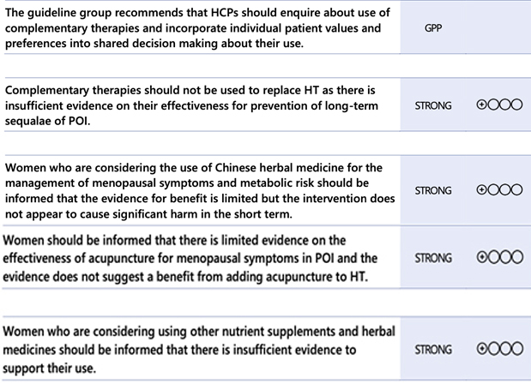
What Complementary Treatments Are Effective For Managing The Sequelae Of POI?
Cao et al., 2022/ Jo et al., 2015, Li et al., 2020b/Safiyeh et al., 2021

Slide 57
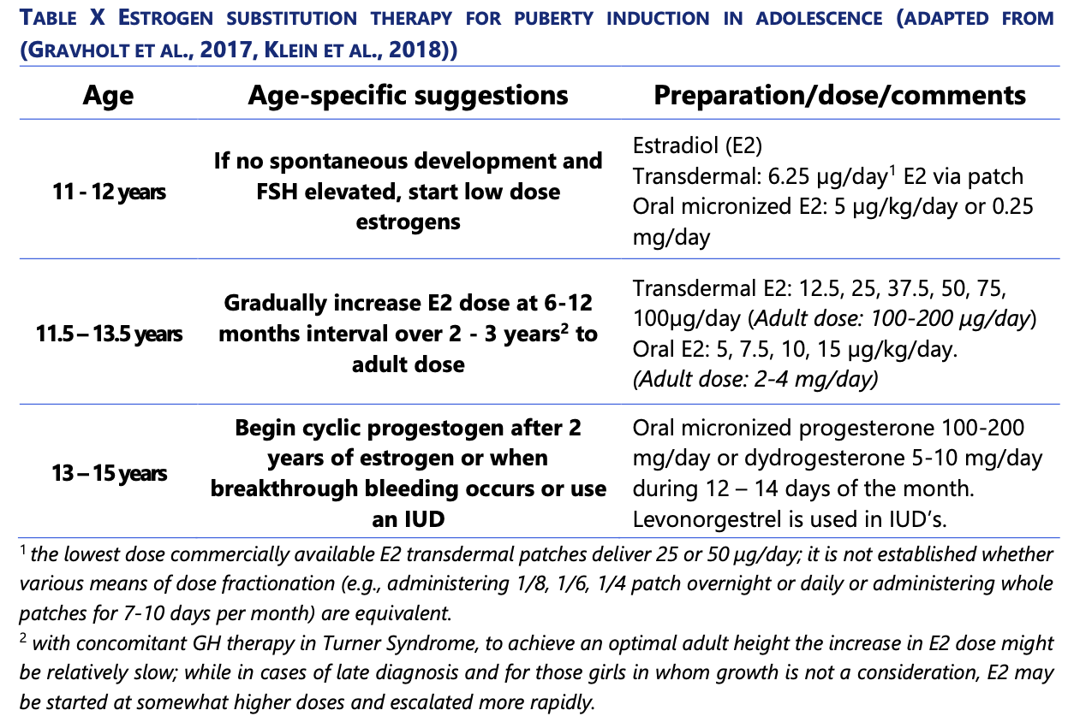
Puberty Induction

Slide 58
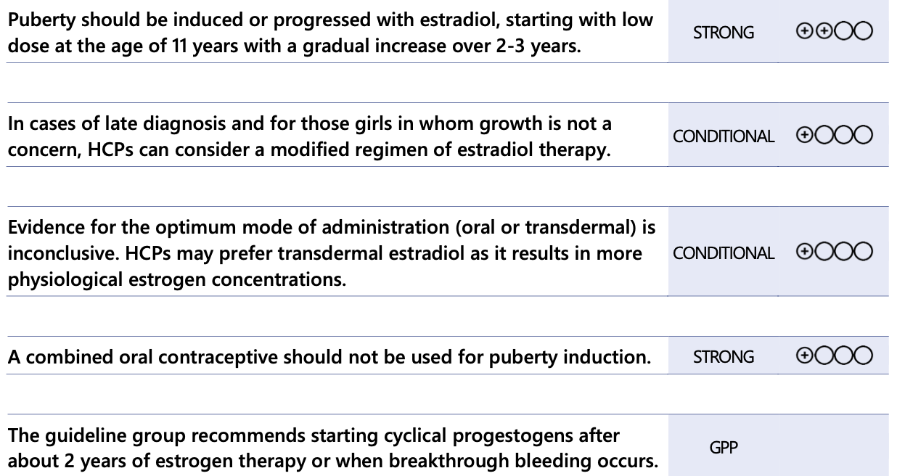
How Should Puberty Be Induced?
Rodari et al., 2023 /Li et al., 2019, O'Donoghue et al., 2020

Slide 59
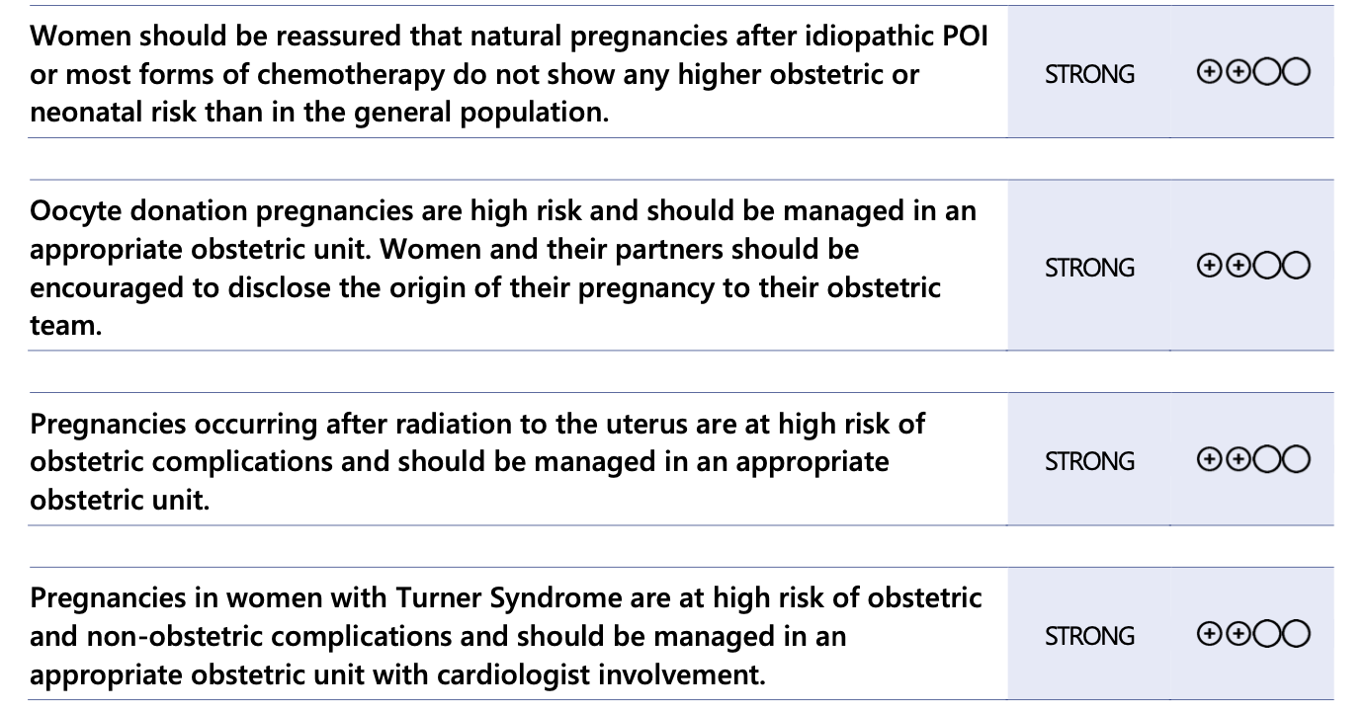
What Are the Obstetric Risks Associated with POI?
van der Kooi et al., 2019 / Nolan et al., 2020/ Griffiths et al., 2020/ van de Loo et al., 2019
Notes:
(Ji et al., 2016) / (Grewal et al., 2021). / (Kalra et al., 2019). /(Keukens et al., 2022). / (Griffiths et,al 2022) /
/

Slide 60
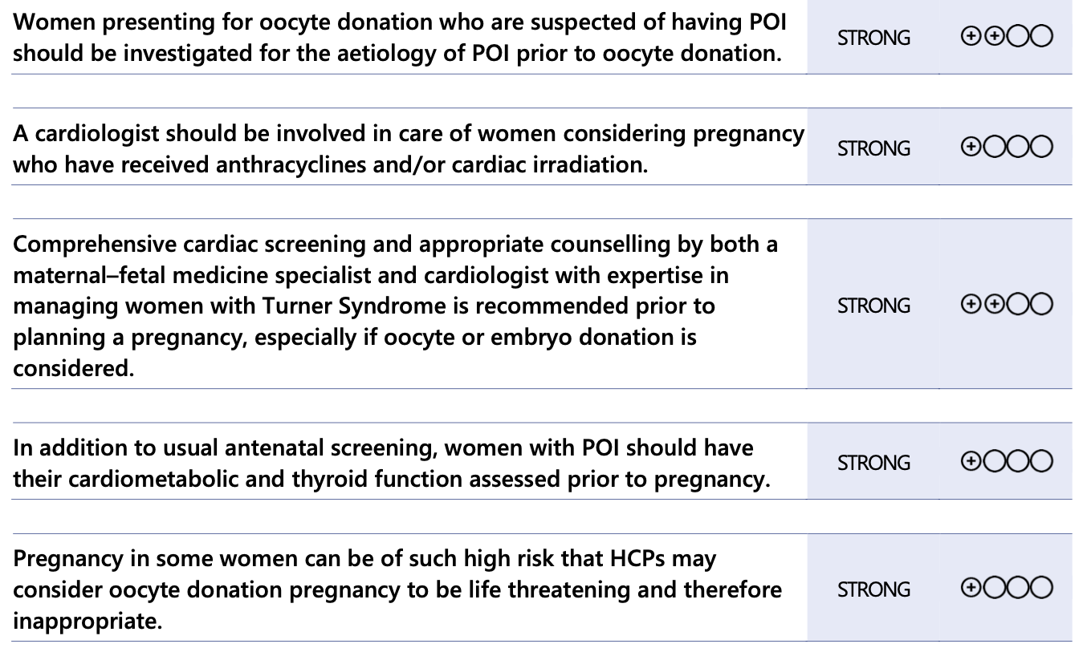
How Should Fitness for Pregnancy Be Assessed in Women with POI?
Bachelot et al., 2017, Fraison et al., 2019, Cambray et al., 2023/Cambray et al., 2023
Notes:
(Bansal et al., 2022, Ehrhardt et al 2023 / (Gravholt et al., 2017, Gravholt et al., 2024) /

Slide 61
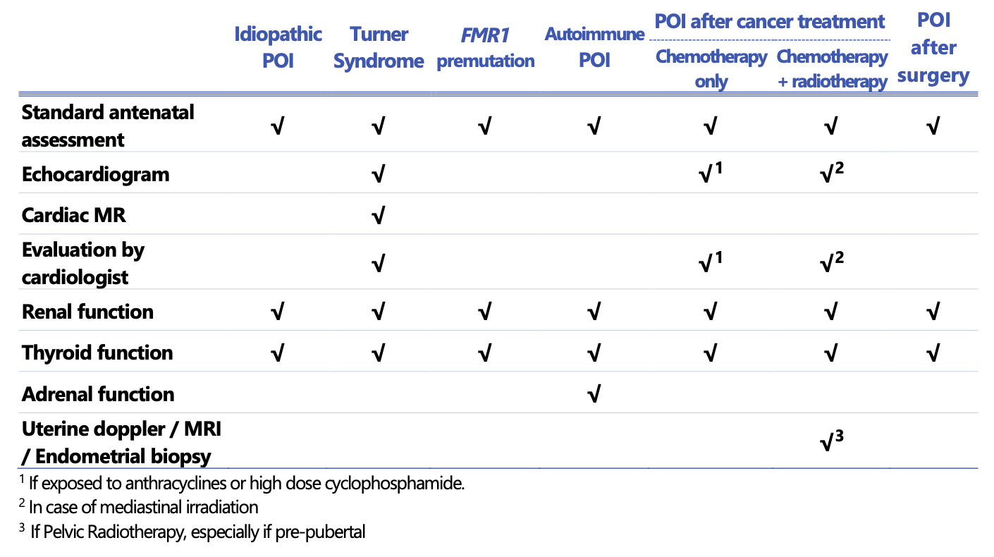
Summary– Assessing Fitness For Pregnancy In POI

Slide 62
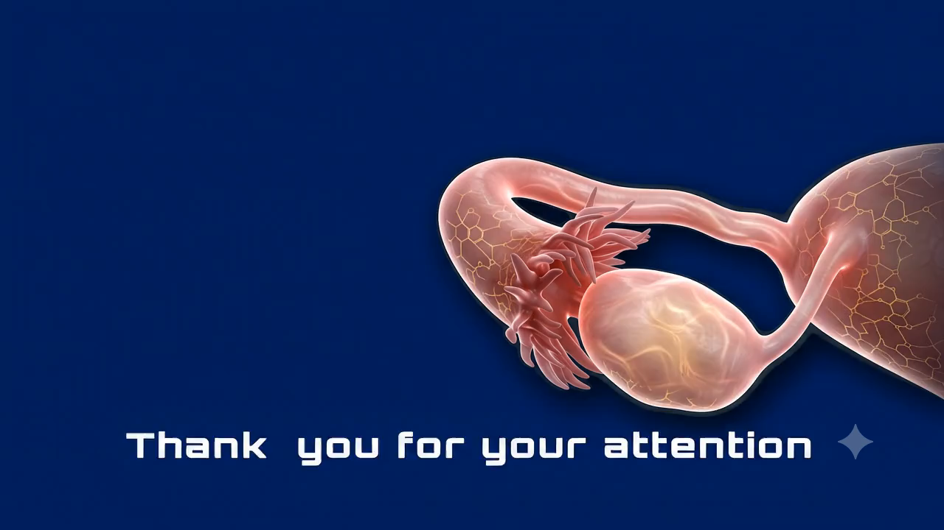

Slide 63


